Slide 1
Reading meters and
Creating the customer ledger

Slide 2
Step 1: Create the meter reading map

Slide 3
Map for meter reader
Use a map of the town that shows where customers and meters are located. Community maps from the DCRA or Google Maps (or similar service) will work well.
Create a route for the meter reader to follow that limits travel time
Include customer names/numbers or meter numbers on the map so the meter reader can follow the map and the meter reading sheet
The route and customer/meter numbers can be handwritten or done on the computer
Meter reading sheet will follow route
*
*
*
*
*
*
*
*
*
*
*
*
*
*
*
*
*
*
*
*
*
*
*

Slide 4
Step 2: Create the meter reading sheet

Slide 5
Meter reading: Correct meter
Route # | Customer # | Meter # | Customer class | Customer Name | Customer address/location | Notes about meter location, other
10 | 352 | 91654 | R | Patao, Preston | 14 Main Street
20 | 146 | 4970878 | R | Bagley, Felicia | 24 Main Street
30 | 472 | 8288190 | CF | Water treatment | 42 Main Street | To left of washeteria meter
40 | 784 | 87402695 | CF | Washeteria | 68 Main Street | To right of water treatment meter
50 | 268 | 23226130 | R | Mccook, Ranae | 88 Main Street
60 | 781 | 58234867 | CF | Village council | 30 Frost Street
70 | 433 | 58849395 | FS | US Post Office | 50 Frost Street
80 | 274 | 62196874 | R | Bross, Polly | 82 Frost Street
90 | 92 | 65795659 | R | Bruss, Rosario | 90 Frost Street
100 | 194 | 34707414 | R | Rojas, Alyssa | 83 Spruce Street
110 | 367 | 36254846 | R | Kiddy, Adrianne | 75 Spruce Street
120 | 151 | 47859795 | R | Brinson, Tennie | 63 Spruce Street
130 | 278 | 48643974 | R | Candy, Chanda | 33 Spruce Street
140 | 585 | 42925745 | C | School #1 | 15 Spruce Street | On SW corner of school
150 | 585 | 53169183 | C | School #2 | 13 Spruce Street | On NE corner of school
160 | 203 | 56888693 | R | Cadle, Lydia | 22 Spruce Street
170 | 31 | 67850176 | R | Boehm, Sheldon | 44 Spruce Street
180 | 196 | 68151075 | R | Degroff, Melinda | 13 Frost Road
190 | 53 | 77112727 | R | Dambrosia, Vida | 5 Frost Road
200 | 269 | 78544302 | R | Bump, Stephen | 63 Main Street
210 | 444 | 83790941 | C | Telephone utility | 43 Main Street
220 | 171 | 91456558 | R | Judge, Alva | 33 Main Street
230 | 606 | 94164794 | C | Native Store | 13 Main Street
240 | 571 | 23360131 | CF | Streetlight | 1 Main Street | 15 streetlights based on one meter
Sheet provided to meter reader should:
Be in the order that the meters will be read
Include a route # so that the sheet can be sorted for meter reading. In the current case it counts by ten. This would allow new customers to be added without renumbering all of the route numbers.
Include customer #
  Makes sure the reading is recorded under correct customer
Meter #
  Meter reader can make sure reading the correct meter
Customer class will allow the meter reading sheet to be sorted to make it easier to fill in the customer ledger
Location
  Could be an address or other location information
Notes
  Additional information that will help the meter reader be accurate

Slide 6
Meter reading: Previous reading info
Customer # | Meter # | Customer Name |  | Meter Multiplier | kWh used last period | Previous Date | Previous meter reading
352 | 91654 | Patao, Preston |  | 1 | 217 | 1/1/2018 | 92092
146 | 4970878 | Bagley, Felicia |  | 1 | 266 | 1/1/2018 | 23534
472 | 8288190 | Water treatment |  | 1 | 1505 | 1/1/2018 | 48338
784 | 87402695 | Washeteria |  | 1 | 3695 | 1/1/2018 | 56151
268 | 23226130 | Mccook, Ranae |  | 1 | 546 | 1/1/2018 | 91491
781 | 58234867 | Village council |  | 1 | 236 | 1/1/2018 | 19380
433 | 58849395 | US Post Office |  | 1 | 598 | 1/1/2018 | 79614
274 | 62196874 | Bross, Polly |  | 1 | 271 | 1/1/2018 | 65176
92 | 65795659 | Bruss, Rosario |  | 1 | 284 | 1/1/2018 | 39443
194 | 34707414 | Rojas, Alyssa |  | 1 | 299 | 1/1/2018 | 98724
367 | 36254846 | Kiddy, Adrianne |  | 1 | 39 | 1/1/2018 | 37954
151 | 47859795 | Brinson, Tennie |  | 1 | 673 | 1/1/2018 | 75133
278 | 48643974 | Candy, Chanda |  | 1 | 58 | 1/1/2018 | 94924
585 | 42925745 | School #1 |  | 20 | 8700 | 1/1/2018 | 2923.5
585 | 53169183 | School #2 |  | 10 | 250 | 1/1/2018 | 8259.4
203 | 56888693 | Cadle, Lydia |  | 1 | 315 | 1/1/2018 | 69874
31 | 67850176 | Boehm, Sheldon |  | 1 | 229 | 1/1/2018 | 94251
196 | 68151075 | Degroff, Melinda |  | 1 | 564 | 1/1/2018 | 84428
53 | 77112727 | Dambrosia, Vida |  | 1 | 459 | 1/1/2018 | 42857
269 | 78544302 | Bump, Stephen |  | 1 | 212 | 1/1/2018 | 55283
444 | 83790941 | Telephone utility |  | 10 | 2503 | 1/1/2018 | 1696.7
171 | 91456558 | Judge, Alva |  | 1 | 348 | 1/1/2018 | 28819
606 | 94164794 | Native Store |  | 1 | 2400 | 1/1/2018 | 34368
571 | 23360131 | Streetlight |  | 15 | 35 | 1/1/2018 | 32366
Sheet provided to meter reader should:
Include any multipliers on the meter
kWh used in last period
Previous meter reading
Date of previous meter read
Any other information that may need be needed to bill customer correctly
Needs to be updated each month
Note: Some columns hidden to make easier to read

Slide 7
Meter reading: Current reading info
Customer # | Meter # | Customer Name |  | Current Date | Current meter reading | Number of days in period | kWh used current period
352 | 91654 | Patao, Preston
146 | 4970878 | Bagley, Felicia
472 | 8288190 | Water treatment
784 | 87402695 | Washeteria
268 | 23226130 | Mccook, Ranae
781 | 58234867 | Village council
433 | 58849395 | US Post Office
274 | 62196874 | Bross, Polly
92 | 65795659 | Bruss, Rosario
194 | 34707414 | Rojas, Alyssa
367 | 36254846 | Kiddy, Adrianne
151 | 47859795 | Brinson, Tennie
278 | 48643974 | Candy, Chanda
585 | 42925745 | School #1
585 | 53169183 | School #2
203 | 56888693 | Cadle, Lydia
31 | 67850176 | Boehm, Sheldon
196 | 68151075 | Degroff, Melinda
53 | 77112727 | Dambrosia, Vida
269 | 78544302 | Bump, Stephen
444 | 83790941 | Telephone utility
171 | 91456558 | Judge, Alva
606 | 94164794 | Native Store
571 | 23360131 | Streetlight
Sheet should include blank spaces for the meter reader to record:
Current date of meter read
Current meter reading
Number of days since the last meter read
kWh used in current period
Note: Some columns hidden to make easier to read

Slide 8
Meter reading: Template
Meter reads
Customer # | Meter # | Customer Name | Customer address/location | Notes about meter location, other | Meter Multiplier | kWh used last period | Previous Date | Previous meter reading | Current Date | Current meter reading | Number of days in period | kWh used current period
352 | 91654 | Patao, Preston | 14 Main Street |  | 1 | 217 | 1/1/2018 | 92092
146 | 4970878 | Bagley, Felicia | 24 Main Street |  | 1 | 266 | 1/1/2018 | 23534
472 | 8288190 | Water treatment | 42 Main Street | To left of washeteria meter | 1 | 1505 | 1/1/2018 | 48338
784 | 87402695 | Washeteria | 68 Main Street | To right of water treatment meter | 1 | 3695 | 1/1/2018 | 56151
268 | 23226130 | Mccook, Ranae | 88 Main Street |  | 1 | 546 | 1/1/2018 | 91491
781 | 58234867 | Village council | 30 Frost Street |  | 1 | 236 | 1/1/2018 | 19380
433 | 58849395 | US Post Office | 50 Frost Street |  | 1 | 598 | 1/1/2018 | 79614
274 | 62196874 | Bross, Polly | 82 Frost Street |  | 1 | 271 | 1/1/2018 | 65176
92 | 65795659 | Bruss, Rosario | 90 Frost Street |  | 1 | 284 | 1/1/2018 | 39443
194 | 34707414 | Rojas, Alyssa | 83 Spruce Street |  | 1 | 299 | 1/1/2018 | 98724
367 | 36254846 | Kiddy, Adrianne | 75 Spruce Street |  | 1 | 39 | 1/1/2018 | 37954
151 | 47859795 | Brinson, Tennie | 63 Spruce Street |  | 1 | 673 | 1/1/2018 | 75133
278 | 48643974 | Candy, Chanda | 33 Spruce Street |  | 1 | 58 | 1/1/2018 | 94924
585 | 42925745 | School #1 | 15 Spruce Street | On SW corner of school | 20 | 8700 | 1/1/2018 | 2923.5
585 | 53169183 | School #2 | 13 Spruce Street | On NE corner of school | 10 | 250 | 1/1/2018 | 8259.4
203 | 56888693 | Cadle, Lydia | 22 Spruce Street |  | 1 | 315 | 1/1/2018 | 69874
31 | 67850176 | Boehm, Sheldon | 44 Spruce Street |  | 1 | 229 | 1/1/2018 | 94251
196 | 68151075 | Degroff, Melinda | 13 Frost Road |  | 1 | 564 | 1/1/2018 | 84428
53 | 77112727 | Dambrosia, Vida | 5 Frost Road |  | 1 | 459 | 1/1/2018 | 42857
269 | 78544302 | Bump, Stephen | 63 Main Street |  | 1 | 212 | 1/1/2018 | 55283
444 | 83790941 | Telephone utility | 43 Main Street |  | 10 | 2503 | 1/1/2018 | 1696.7
171 | 91456558 | Judge, Alva | 33 Main Street |  | 1 | 348 | 1/1/2018 | 28819
606 | 94164794 | Native Store | 13 Main Street |  | 1 | 2400 | 1/1/2018 | 34368
571 | 23360131 | Streetlight | 1 Main Street | 15 streetlights based on one meter | 15 | 35 | 1/1/2018 | 32366

Slide 9
Step 3: Read the meters and calculate kWh consumed

Slide 10
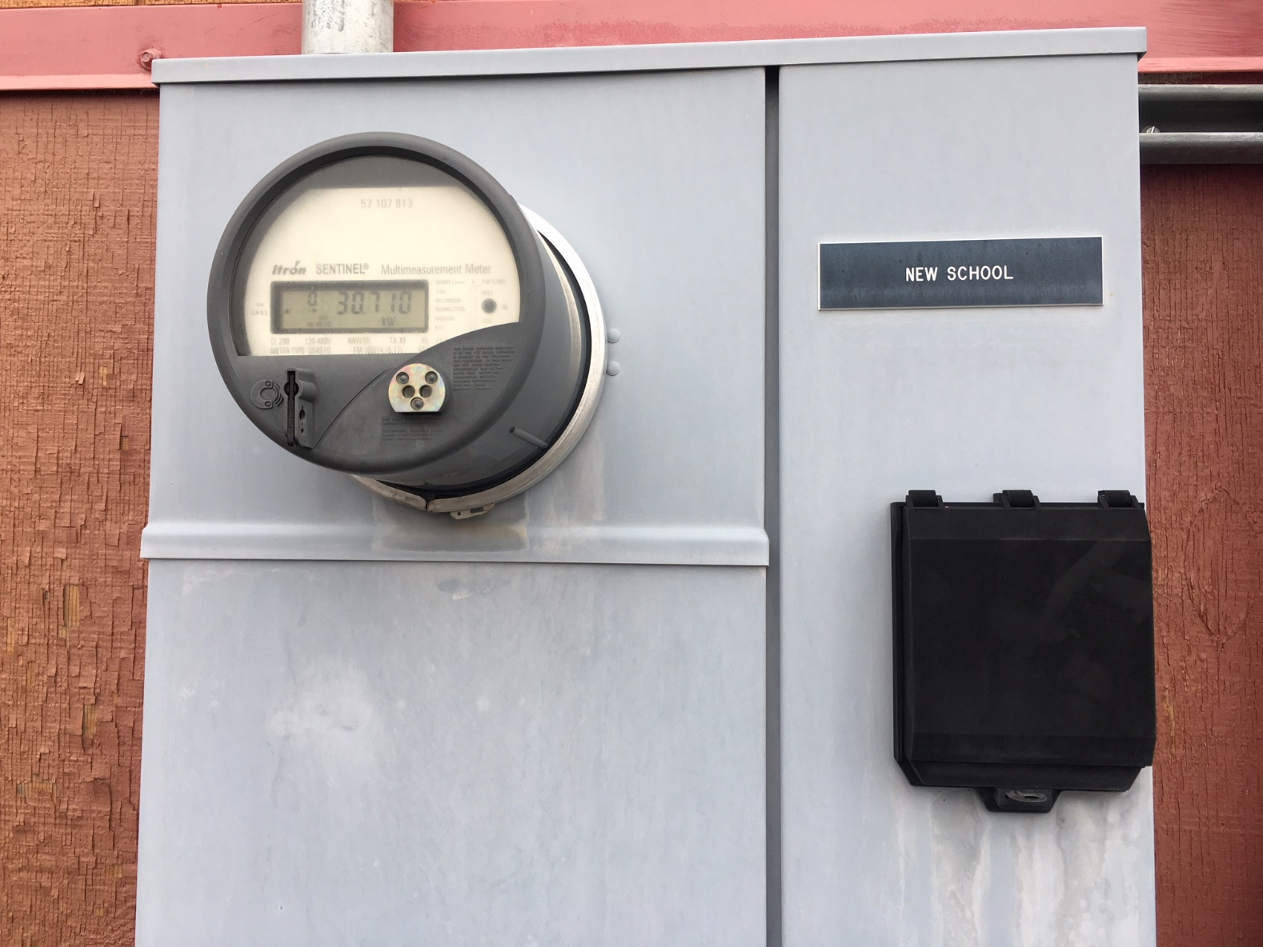
Common meter types
Analog
Odometer-style
Odometer-style with multiplier
Digital

Slide 11
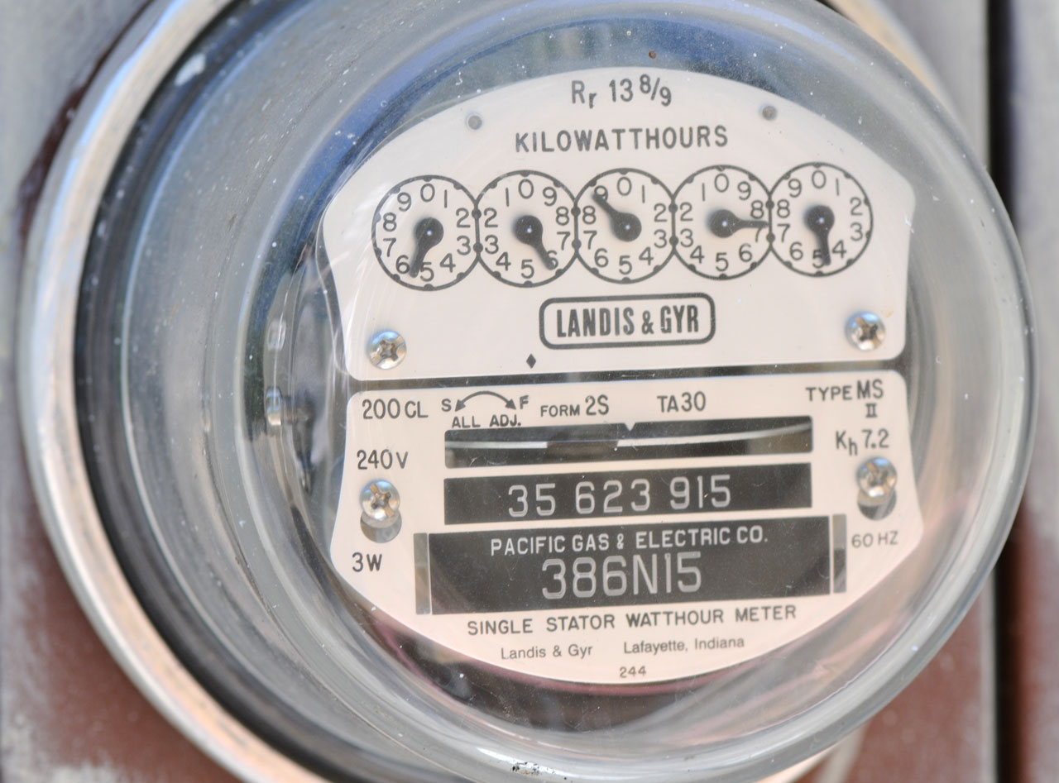
Read Meter: Analog
Read the dials like a clock, except each dial rotates in different direction—follow numbers clockwise or counterclockwise from the smallest to largest number.
  Red arrows were added to the photo show rotations for each dial
Record the numbers starting from the right.
If the dial not on a number, round down to previous number
  For instance, the rightmost dial is almost to 5, but not quite. Record the number as 4.
  If the dial is between 9 and 0, record the number as 9. If the dial is between 1 and 0, record the number as 0.
The reading on this meter is: 55874
5
5
8
7
4

Slide 12
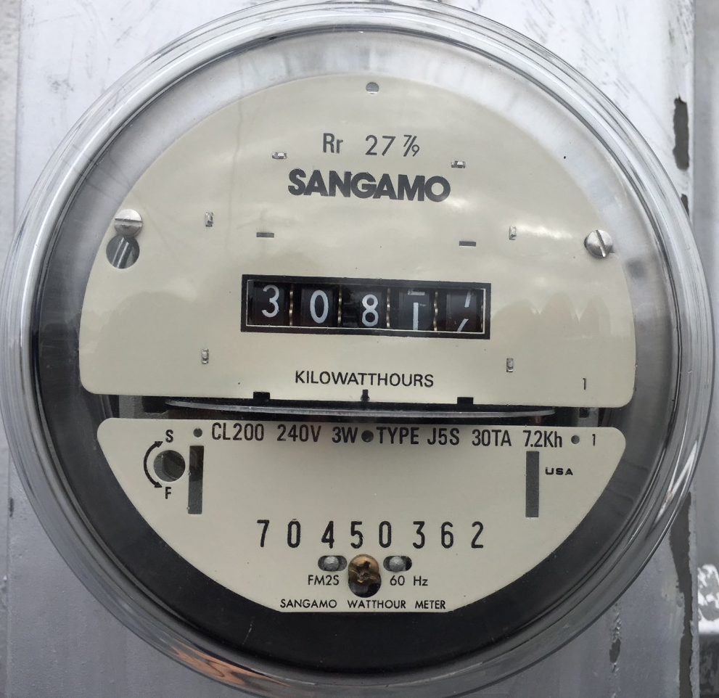
Read Meter: Odometer-style
Read left to right, like a car’s odometer
If between numbers, use lower value
The meter to the left should be read as: 30816
Meter serial numbers are generally 8 digits
Meter serial number

Slide 13
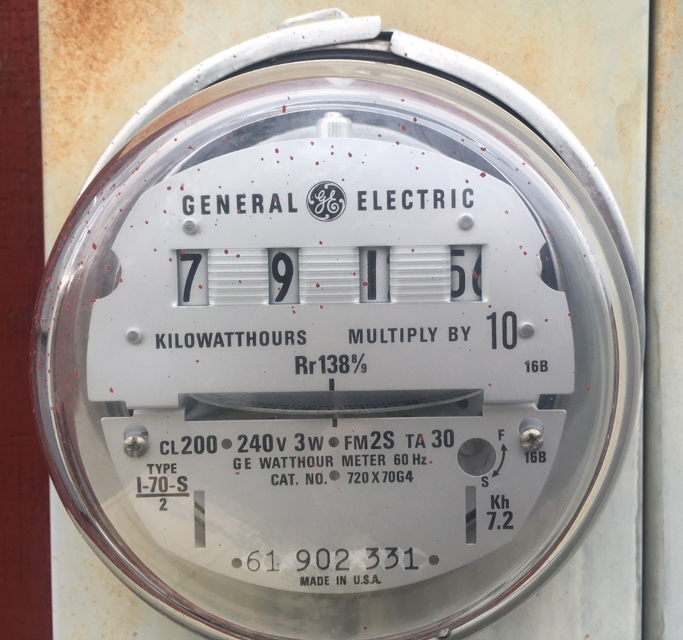
Read Meter: Odometer-style with multiplier
Read left to right, like a car’s odometer
If the dial is between numbers, use the lower value
This meter includes a “Multiply by 10”
This meter should be recorded as 7915.
  Multipliers should be applied after the meter has been recorded. If done in Excel or other spreadsheet, the multiplication can be automated to reduce errors.
Meter serial number

Slide 14
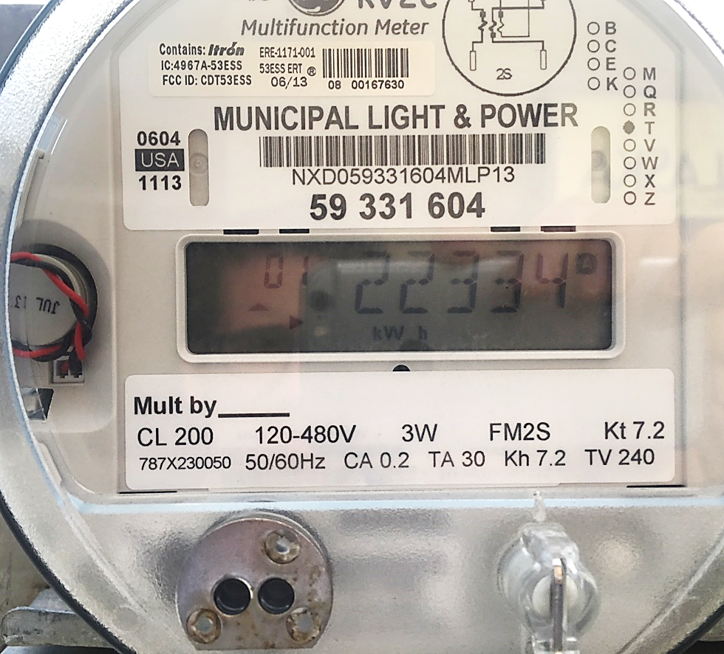
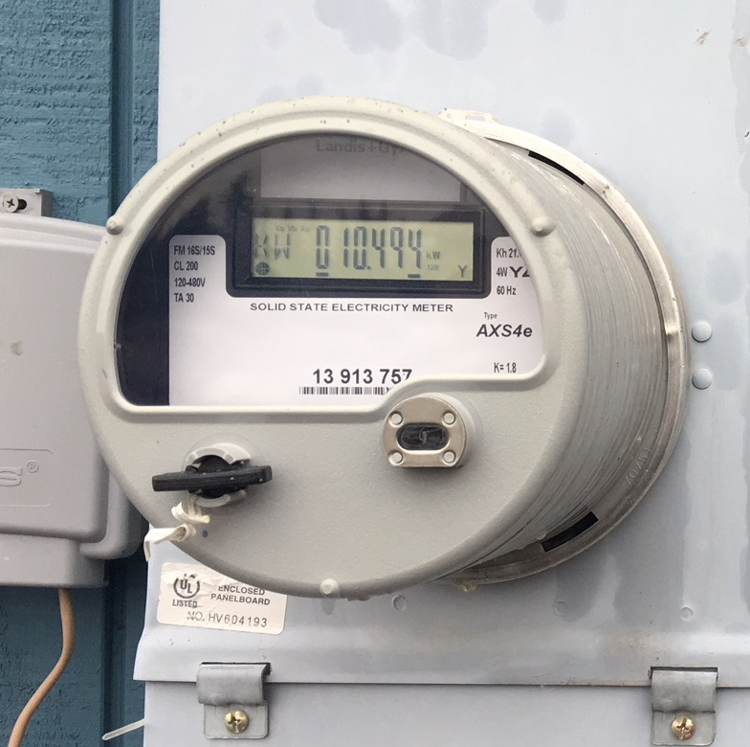
Read meter: Digital Meter
The meter below displays the highest power in kilowatts (kW) that the meter had registered since it had last been reset
Read the meter left to right. Make sure that it is displaying kWh. Some digital meters display other data as well, such as the photo to the right.

Slide 15
Read meter: CT

Slide 16
Record meter readings
Meter reads
Customer # | Meter # | Customer Name | Customer address/location | Notes about meter location, other | Meter Multiplier | kWh used last period | Previous Date | Previous meter reading | Current Date | Current meter reading | Number of days in period | kWh used current period
352 | 91654 | Patao, Preston | 14 Main Street |  | 1 | 217 | 1/1/2018 | 92092 | 2/1/2018 | 92228
146 | 4970878 | Bagley, Felicia | 24 Main Street |  | 1 | 266 | 1/1/2018 | 23534 | 2/1/2018 | 23534
472 | 8288190 | Water treatment | 42 Main Street | To left of washeteria meter | 1 | 1505 | 1/1/2018 | 48338 | 2/1/2018 | 49744
784 | 87402695 | Washeteria | 68 Main Street | To right of water treatment meter | 1 | 3695 | 1/1/2018 | 56151 | 2/1/2018 | 59654
268 | 23226130 | Mccook, Ranae | 88 Main Street |  | 1 | 546 | 1/1/2018 | 91491 | 2/1/2018 | 91724
781 | 58234867 | Village council | 30 Frost Street |  | 1 | 236 | 1/1/2018 | 19380 | 2/1/2018 | 19422
433 | 58849395 | US Post Office | 50 Frost Street |  | 1 | 598 | 1/1/2018 | 79614 | 2/1/2018 | 79958
274 | 62196874 | Bross, Polly | 82 Frost Street |  | 1 | 271 | 1/1/2018 | 65176 | 2/1/2018 | 66112
92 | 65795659 | Bruss, Rosario | 90 Frost Street |  | 1 | 284 | 1/1/2018 | 39443 | 2/1/2018 | 39443
194 | 34707414 | Rojas, Alyssa | 83 Spruce Street |  | 1 | 299 | 1/1/2018 | 98724 | 2/1/2018 | 99053
367 | 36254846 | Kiddy, Adrianne | 75 Spruce Street |  | 1 | 39 | 1/1/2018 | 37954 | 2/1/2018 | 38126
151 | 47859795 | Brinson, Tennie | 63 Spruce Street |  | 1 | 673 | 1/1/2018 | 75133 | 2/1/2018 | 75833
278 | 48643974 | Candy, Chanda | 33 Spruce Street |  | 1 | 58 | 1/1/2018 | 94924 | 2/1/2018 | 94980
585 | 42925745 | School #1 | 15 Spruce Street | On SW corner of school | 20 | 8700 | 1/1/2018 | 2923 | 2/1/2018 | 3346
585 | 53169183 | School #2 | 13 Spruce Street | On NE corner of school | 10 | 250 | 1/1/2018 | 8259 | 2/1/2018 | 8272
203 | 56888693 | Cadle, Lydia | 22 Spruce Street |  | 1 | 315 | 1/1/2018 | 69874 | 2/1/2018 | 70036
31 | 67850176 | Boehm, Sheldon | 44 Spruce Street |  | 1 | 229 | 1/1/2018 | 94251 | 2/1/2018 | 94381
196 | 68151075 | Degroff, Melinda | 13 Frost Road |  | 1 | 564 | 1/1/2018 | 84428 | 2/1/2018 | 84854
53 | 77112727 | Dambrosia, Vida | 5 Frost Road |  | 1 | 459 | 1/1/2018 | 42857 | 2/1/2018 | 43023
269 | 78544302 | Bump, Stephen | 63 Main Street |  | 1 | 212 | 1/1/2018 | 55283 | 2/1/2018 | 55310
444 | 83790941 | Telephone utility | 43 Main Street |  | 10 | 2503 | 1/1/2018 | 1696.7 | 2/1/2018 | 1920.7
171 | 91456558 | Judge, Alva | 33 Main Street |  | 1 | 348 | 1/1/2018 | 28819 | 2/1/2018 | 28843
606 | 94164794 | Native Store | 13 Main Street |  | 1 | 2400 | 1/1/2018 | 34368 | 2/1/2018 | 36579
571 | 23360131 | Streetlight | 1 Main Street | 15 streetlights based on one meter | 15 | 35 | 1/1/2018 | 32366 | 2/1/2018 | 32389
Record the date
Record the current reading

Slide 17
Check meter reads: Calculating kWh used
Meter reads
Customer # | Meter # | Customer Name | Meter Multiplier | kWh used last period | Previous Date | Previous meter reading | Current Date | Current meter reading | Number of days in period | kWh used current period
352 | 91654 | Patao, Preston | 1 | 217 | 1/1/2018 | 92092 | 2/1/2018 | 92228 | 31 | 136
146 | 4970878 | Bagley, Felicia | 1 | 266 | 1/1/2018 | 23534 | 2/1/2018 | 23534 | 31 | 0
472 | 8288190 | Water treatment | 1 | 1505 | 1/1/2018 | 48338 | 2/1/2018 | 49744 | 31 | 1406
784 | 87402695 | Washeteria | 1 | 3695 | 1/1/2018 | 56151 | 2/1/2018 | 59654 | 31 | 3503
268 | 23226130 | Mccook, Ranae | 1 | 546 | 1/1/2018 | 91491 | 2/1/2018 | 91724 | 31 | 233
$$kWh used=Meter multiplier ∗(Current reading−previous reading)$$
$$kWh used=1∗(92228−92092)$$
$$kWh used=1∗(136)$$
$kWh used=136$ kWh
Note: Rows and columns removed to make easier to read

Slide 18
Check meter reads: Calculating kWh used with meter multiplier
Meter reads
Customer # | Meter # | Customer Name | Meter Multiplier | kWh used last period | Previous Date | Previous meter reading | Current Date | Current meter reading | Number of days in period | kWh used current period
585 | 42925745 | School #1 | 20 | 8700 | 1/1/2018 | 2923 | 2/1/2018 | 3346 | 31 | 8460
647 | 53169183 | School #2 | 10 | 250 | 1/1/2018 | 8259 | 2/1/2018 | 8272 | 31 | 128
203 | 56888693 | Cadle, Lydia | 1 | 315 | 1/1/2018 | 69874 | 2/1/2018 | 70036 | 31 | 162
31 | 67850176 | Boehm, Sheldon | 1 | 229 | 1/1/2018 | 94251 | 2/1/2018 | 94381 | 31 | 130
196 | 68151075 | Degroff, Melinda | 1 | 564 | 1/1/2018 | 84428 | 2/1/2018 | 84854 | 31 | 426
53 | 77112727 | Dambrosia, Vida | 1 | 459 | 1/1/2018 | 42857 | 2/1/2018 | 43023 | 31 | 166
269 | 78544302 | Bump, Stephen | 1 | 212 | 1/1/2018 | 55283 | 2/1/2018 | 55310 | 31 | 27
444 | 83790941 | Telephone utility | 10 | 2503 | 1/1/2018 | 1696 | 2/1/2018 | 1920 | 31 | 2240
171 | 91456558 | Judge, Alva | 1 | 348 | 1/1/2018 | 28819 | 2/1/2018 | 28843 | 31 | 24
606 | 94164794 | Native Store | 1 | 2400 | 1/1/2018 | 34368 | 2/1/2018 | 36579 | 31 | 2211
571 | 23360131 | Streetlight | 15 | 525 | 1/1/2018 | 32366 | 2/1/2018 | 32389 | 31 | 345
$$kWh used=Meter multiplier ∗(Current reading−previous reading)$$
$$kWh used=20∗(3346−2923)$$
$$kWh used=20∗(423)$$
$kWh used=8,46$0 kWh
Note: Rows and columns removed to make easier to read

Slide 19
Meter reading: Completed
Meter reads
Customer # | Meter # | Customer Name | Customer address/location | Notes about meter location, other | Meter Multiplier | kWh used last period | Previous Date | Previous meter reading | Current Date | Current meter reading | Number of days in period | kWh used current period
352 | 91654 | Patao, Preston | 14 Main Street |  | 1 | 217 | 1/1/2018 | 92092 | 2/1/2018 | 92228 | 31 | 136
146 | 4970878 | Bagley, Felicia | 24 Main Street |  | 1 | 266 | 1/1/2018 | 23534 | 2/1/2018 | 23534 | 31 | 0
472 | 8288190 | Water treatment | 42 Main Street | To left of washeteria meter | 1 | 1505 | 1/1/2018 | 48338 | 2/1/2018 | 49744 | 31 | 1406
784 | 87402695 | Washeteria | 68 Main Street | To right of water treatment meter | 1 | 3695 | 1/1/2018 | 56151 | 2/1/2018 | 59654 | 31 | 3503
268 | 23226130 | Mccook, Ranae | 88 Main Street |  | 1 | 546 | 1/1/2018 | 91491 | 2/1/2018 | 91724 | 31 | 233
781 | 58234867 | Village council | 30 Frost Street |  | 1 | 236 | 1/1/2018 | 19380 | 2/1/2018 | 19422 | 31 | 42
433 | 58849395 | US Post Office | 50 Frost Street |  | 1 | 598 | 1/1/2018 | 79614 | 2/1/2018 | 79958 | 31 | 344
274 | 62196874 | Bross, Polly | 82 Frost Street |  | 1 | 271 | 1/1/2018 | 65176 | 2/1/2018 | 66112 | 31 | 936
92 | 65795659 | Bruss, Rosario | 90 Frost Street |  | 1 | 284 | 1/1/2018 | 39443 | 2/1/2018 | 39443 | 31 | 0
194 | 34707414 | Rojas, Alyssa | 83 Spruce Street |  | 1 | 299 | 1/1/2018 | 98724 | 2/1/2018 | 99053 | 31 | 329
367 | 36254846 | Kiddy, Adrianne | 75 Spruce Street |  | 1 | 39 | 1/1/2018 | 37954 | 2/1/2018 | 38126 | 31 | 172
151 | 47859795 | Brinson, Tennie | 63 Spruce Street |  | 1 | 673 | 1/1/2018 | 75133 | 2/1/2018 | 75833 | 31 | 700
278 | 48643974 | Candy, Chanda | 33 Spruce Street |  | 1 | 58 | 1/1/2018 | 94924 | 2/1/2018 | 94980 | 31 | 56
585 | 42925745 | School #1 | 15 Spruce Street | On SW corner of school | 20 | 8700 | 1/1/2018 | 2923 | 2/1/2018 | 3346 | 31 | 8466
585 | 53169183 | School #2 | 13 Spruce Street | On NE corner of school | 10 | 250 | 1/1/2018 | 8259 | 2/1/2018 | 8272 | 31 | 130
203 | 56888693 | Cadle, Lydia | 22 Spruce Street |  | 1 | 315 | 1/1/2018 | 69874 | 2/1/2018 | 70036 | 31 | 162
31 | 67850176 | Boehm, Sheldon | 44 Spruce Street |  | 1 | 229 | 1/1/2018 | 94251 | 2/1/2018 | 94381 | 31 | 130
196 | 68151075 | Degroff, Melinda | 13 Frost Road |  | 1 | 564 | 1/1/2018 | 84428 | 2/1/2018 | 84854 | 31 | 426
53 | 77112727 | Dambrosia, Vida | 5 Frost Road |  | 1 | 459 | 1/1/2018 | 42857 | 2/1/2018 | 43023 | 31 | 166
269 | 78544302 | Bump, Stephen | 63 Main Street |  | 1 | 212 | 1/1/2018 | 55283 | 2/1/2018 | 55310 | 31 | 27
444 | 83790941 | Telephone utility | 43 Main Street |  | 10 | 2503 | 1/1/2018 | 1696 | 2/1/2018 | 1920 | 31 | 2240
171 | 91456558 | Judge, Alva | 33 Main Street |  | 1 | 348 | 1/1/2018 | 28819 | 2/1/2018 | 28843 | 31 | 24
606 | 94164794 | Native Store | 13 Main Street |  | 1 | 2400 | 1/1/2018 | 34368 | 2/1/2018 | 36579 | 31 | 2211
571 | 23360131 | Streetlight | 1 Main Street | 15 streetlights based on one meter | 15 | 35 | 1/1/2018 | 32366 | 2/1/2018 | 32389 | 31 | 345

Slide 20
Step 4: Check the meter readings for accuracy

Slide 21
Check meter reads: Review and verify kWh used in current period
Meter reads
Customer # | Meter # | Customer Name | Meter Multiplier | kWh used last period | Previous Date | Previous meter reading | Current Date | Current meter reading | Number of days in period | kWh used current period
352 | 91654 | Patao, Preston | 1 | 217 | 1/1/2018 | 92092 | 2/1/2018 | 92228 | 31 | 136
146 | 4970878 | Bagley, Felicia | 1 | 266 | 1/1/2018 | 23534 | 2/1/2018 | 23534 | 31 | 0
472 | 8288190 | Water treatment | 1 | 1505 | 1/1/2018 | 48338 | 2/1/2018 | 49744 | 31 | 1406
784 | 87402695 | Washeteria | 1 | 3695 | 1/1/2018 | 56151 | 2/1/2018 | 59654 | 31 | 3503
268 | 23226130 | Mccook, Ranae | 1 | 546 | 1/1/2018 | 91491 | 2/1/2018 | 91724 | 31 | 233
781 | 58234867 | Village council | 1 | 236 | 1/1/2018 | 19380 | 2/1/2018 | 19422 | 31 | 42
433 | 58849395 | US Post Office | 1 | 598 | 1/1/2018 | 79614 | 2/1/2018 | 79958 | 31 | 344
274 | 62196874 | Bross, Polly | 1 | 271 | 1/1/2018 | 65176 | 2/1/2018 | 66112 | 31 | 936
92 | 65795659 | Bruss, Rosario | 1 | 284 | 1/1/2018 | 39443 | 2/1/2018 | 39443 | 31 | 0
194 | 34707414 | Rojas, Alyssa | 1 | 299 | 1/1/2018 | 98724 | 2/1/2018 | 99053 | 31 | 329
367 | 36254846 | Kiddy, Adrianne | 1 | 39 | 1/1/2018 | 37954 | 2/1/2018 | 38126 | 31 | 172
151 | 47859795 | Brinson, Tennie | 1 | 673 | 1/1/2018 | 75133 | 2/1/2018 | 75833 | 31 | 700
278 | 48643974 | Candy, Chanda | 1 | 58 | 1/1/2018 | 94924 | 2/1/2018 | 94980 | 31 | 56
585 | 42925745 | School #1 | 20 | 8700 | 1/1/2018 | 2923 | 2/1/2018 | 3346 | 31 | 8460
585 | 53169183 | School #2 | 10 | 250 | 1/1/2018 | 8259 | 2/1/2018 | 8272 | 31 | 128
203 | 56888693 | Cadle, Lydia | 1 | 315 | 1/1/2018 | 69874 | 2/1/2018 | 70036 | 31 | 162
31 | 67850176 | Boehm, Sheldon | 1 | 229 | 1/1/2018 | 94251 | 2/1/2018 | 94381 | 31 | 130
196 | 68151075 | Degroff, Melinda | 1 | 564 | 1/1/2018 | 84428 | 2/1/2018 | 84854 | 31 | 426
53 | 77112727 | Dambrosia, Vida | 1 | 459 | 1/1/2018 | 42857 | 2/1/2018 | 43023 | 31 | 166
269 | 78544302 | Bump, Stephen | 1 | 212 | 1/1/2018 | 55283 | 2/1/2018 | 55310 | 31 | 27
444 | 83790941 | Telephone utility | 10 | 2503 | 1/1/2018 | 1696 | 2/1/2018 | 1920 | 31 | 2240
171 | 91456558 | Judge, Alva | 1 | 348 | 1/1/2018 | 28819 | 2/1/2018 | 28843 | 31 | 24
606 | 94164794 | Native Store | 1 | 2400 | 1/1/2018 | 34368 | 2/1/2018 | 36579 | 31 | 2211
571 | 23360131 | Streetlight | 15 | 525 | 1/1/2018 | 32366 | 2/1/2018 | 32389 | 31 | 345
Questions:
Are there any meters with a reading of zero?
Did the meter reader take a reading?
Was the customer disconnected?
Out of town?
Does the meter appear to be tampered with?
Note: Columns removed to make easier to read

Slide 22
Check meter reads: Review and verify very low readings
Meter reads
Customer # | Meter # | Customer Name | Meter Multiplier | kWh used last period | Previous Date | Previous meter reading | Current Date | Current meter reading | Number of days in period | kWh used current period
352 | 91654 | Patao, Preston | 1 | 217 | 1/1/2018 | 92092 | 2/1/2018 | 92228 | 31 | 136
146 | 4970878 | Bagley, Felicia | 1 | 266 | 1/1/2018 | 23534 | 2/1/2018 | 23534 | 31 | 0
472 | 8288190 | Water treatment | 1 | 1505 | 1/1/2018 | 48338 | 2/1/2018 | 49744 | 31 | 1406
784 | 87402695 | Washeteria | 1 | 3695 | 1/1/2018 | 56151 | 2/1/2018 | 59654 | 31 | 3503
268 | 23226130 | Mccook, Ranae | 1 | 546 | 1/1/2018 | 91491 | 2/1/2018 | 91724 | 31 | 233
781 | 58234867 | Village council | 1 | 236 | 1/1/2018 | 19380 | 2/1/2018 | 19422 | 31 | 42
433 | 58849395 | US Post Office | 1 | 598 | 1/1/2018 | 79614 | 2/1/2018 | 79958 | 31 | 344
274 | 62196874 | Bross, Polly | 1 | 271 | 1/1/2018 | 65176 | 2/1/2018 | 66112 | 31 | 936
92 | 65795659 | Bruss, Rosario | 1 | 284 | 1/1/2018 | 39443 | 2/1/2018 | 39443 | 31 | 0
194 | 34707414 | Rojas, Alyssa | 1 | 299 | 1/1/2018 | 98724 | 2/1/2018 | 99053 | 31 | 329
367 | 36254846 | Kiddy, Adrianne | 1 | 39 | 1/1/2018 | 37954 | 2/1/2018 | 38126 | 31 | 172
151 | 47859795 | Brinson, Tennie | 1 | 673 | 1/1/2018 | 75133 | 2/1/2018 | 75833 | 31 | 700
278 | 48643974 | Candy, Chanda | 1 | 58 | 1/1/2018 | 94924 | 2/1/2018 | 94980 | 31 | 56
585 | 42925745 | School #1 | 20 | 8700 | 1/1/2018 | 2923 | 2/1/2018 | 3346 | 31 | 8460
585 | 53169183 | School #2 | 10 | 250 | 1/1/2018 | 8259 | 2/1/2018 | 8272 | 31 | 128
203 | 56888693 | Cadle, Lydia | 1 | 315 | 1/1/2018 | 69874 | 2/1/2018 | 70036 | 31 | 162
31 | 67850176 | Boehm, Sheldon | 1 | 229 | 1/1/2018 | 94251 | 2/1/2018 | 94381 | 31 | 130
196 | 68151075 | Degroff, Melinda | 1 | 564 | 1/1/2018 | 84428 | 2/1/2018 | 84854 | 31 | 426
53 | 77112727 | Dambrosia, Vida | 1 | 459 | 1/1/2018 | 42857 | 2/1/2018 | 43023 | 31 | 166
269 | 78544302 | Bump, Stephen | 1 | 212 | 1/1/2018 | 55283 | 2/1/2018 | 55310 | 31 | 27
444 | 83790941 | Telephone utility | 10 | 2503 | 1/1/2018 | 1696 | 2/1/2018 | 1920 | 31 | 2240
171 | 91456558 | Judge, Alva | 1 | 348 | 1/1/2018 | 28819 | 2/1/2018 | 28843 | 31 | 24
606 | 94164794 | Native Store | 1 | 2400 | 1/1/2018 | 34368 | 2/1/2018 | 36579 | 31 | 2211
571 | 23360131 | Streetlight | 15 | 525 | 1/1/2018 | 32366 | 2/1/2018 | 32389 | 31 | 345
Questions:
Is this normal for the customer?
  It seems normal for #2 but not #1
Does it seem reasonable for the type of customer?
Did the meter reader write a number down wrong?
Was the customer disconnected? Out of town?
Is the meter bad?
#1: Significantly lower consumption. Did something change?
#2: Similar consumption. Is the low consumption reasonable?
Note: Columns removed to make easier to read

Slide 23
Check meter reads: Review and verify very high readings
Meter reads
Customer # | Meter # | Customer Name | Meter Multiplier | kWh used last period | Previous Date | Previous meter reading | Current Date | Current meter reading | Number of days in period | kWh used current period
352 | 91654 | Patao, Preston | 1 | 217 | 1/1/2018 | 92092 | 2/1/2018 | 92228 | 31 | 136
146 | 4970878 | Bagley, Felicia | 1 | 266 | 1/1/2018 | 23534 | 2/1/2018 | 23534 | 31 | 0
472 | 8288190 | Water treatment | 1 | 1505 | 1/1/2018 | 48338 | 2/1/2018 | 49744 | 31 | 1406
784 | 87402695 | Washeteria | 1 | 3695 | 1/1/2018 | 56151 | 2/1/2018 | 59654 | 31 | 3503
268 | 23226130 | Mccook, Ranae | 1 | 546 | 1/1/2018 | 91491 | 2/1/2018 | 91724 | 31 | 233
781 | 58234867 | Village council | 1 | 236 | 1/1/2018 | 19380 | 2/1/2018 | 19422 | 31 | 42
433 | 58849395 | US Post Office | 1 | 598 | 1/1/2018 | 79614 | 2/1/2018 | 79958 | 31 | 344
274 | 62196874 | Bross, Polly | 1 | 271 | 1/1/2018 | 65176 | 2/1/2018 | 66112 | 31 | 936
92 | 65795659 | Bruss, Rosario | 1 | 284 | 1/1/2018 | 39443 | 2/1/2018 | 39443 | 31 | 0
194 | 34707414 | Rojas, Alyssa | 1 | 299 | 1/1/2018 | 98724 | 2/1/2018 | 99053 | 31 | 329
367 | 36254846 | Kiddy, Adrianne | 1 | 39 | 1/1/2018 | 37954 | 2/1/2018 | 38126 | 31 | 172
151 | 47859795 | Brinson, Tennie | 1 | 673 | 1/1/2018 | 75133 | 2/1/2018 | 75833 | 31 | 700
278 | 48643974 | Candy, Chanda | 1 | 58 | 1/1/2018 | 94924 | 2/1/2018 | 94980 | 31 | 56
585 | 42925745 | School #1 | 20 | 8700 | 1/1/2018 | 2923 | 2/1/2018 | 3346 | 31 | 8460
585 | 53169183 | School #2 | 10 | 250 | 1/1/2018 | 8259 | 2/1/2018 | 8272 | 31 | 128
203 | 56888693 | Cadle, Lydia | 1 | 315 | 1/1/2018 | 69874 | 2/1/2018 | 70036 | 31 | 162
31 | 67850176 | Boehm, Sheldon | 1 | 229 | 1/1/2018 | 94251 | 2/1/2018 | 94381 | 31 | 130
196 | 68151075 | Degroff, Melinda | 1 | 564 | 1/1/2018 | 84428 | 2/1/2018 | 84854 | 31 | 426
53 | 77112727 | Dambrosia, Vida | 1 | 459 | 1/1/2018 | 42857 | 2/1/2018 | 43023 | 31 | 166
269 | 78544302 | Bump, Stephen | 1 | 212 | 1/1/2018 | 55283 | 2/1/2018 | 55310 | 31 | 27
444 | 83790941 | Telephone utility | 10 | 2503 | 1/1/2018 | 1696 | 2/1/2018 | 1920 | 31 | 2240
171 | 91456558 | Judge, Alva | 1 | 348 | 1/1/2018 | 28819 | 2/1/2018 | 28843 | 31 | 24
606 | 94164794 | Native Store | 1 | 2400 | 1/1/2018 | 34368 | 2/1/2018 | 36579 | 31 | 2211
571 | 23360131 | Streetlight | 15 | 525 | 1/1/2018 | 32366 | 2/1/2018 | 32389 | 31 | 345
Questions:
Is this normal for the customer?
  It seems normal for #2 but not #1
Does it seem reasonable for customer class?
Did the meter reader write a number down wrong?
Was the customer disconnected? Out of town?
Is the meter bad?
#1: Significantly higher consumption. Did something change?
#2: Similar consumption. Is the high consumption reasonable?
Note: Columns removed to make easier to read

Slide 24
Step 5: Bill customers

Slide 25
Customer bill
The customer bill should include:
Customer name and address
Utility contact information
  Name
  Address
  Telephone number
  Email
The date of meter reading and the number of days in billing period
The date payment is due to the utility
Previous balance
Any payments received (including the date of receipt)
Amount of owed in current billing period
  Owed for current consumption
    The amount of kWh consumed, including the previous and current reading
    The rate(s) in $/kWh
    Total amount due
  Other customer charges
  PCE credit
    PCE credit rate in $/kWh
    # of eligible kWh
    Total PCE credit
  Current charges
    Including previous unpaid balance, current energy charges, other customer charges, and PCE credit

Slide 26
Notices required on bills
PCE credit notice
Fuel efficiency notice
“For the current billing period, the utility will be paid under the State of Alaska’s Power Cost Equalization Program (AS 42.45.100) to assist the utility and it’s customer in reducing the high cost of generation of electric energy.”
“For the reporting period that ended 1/31/2018 under State of Alaska’s Power Cost Equalization Program, this utility’s actual fuel efficiency for your community was xx.xx kilowatt-hours per gallon. The acceptable fuel efficiency set out in regulations for the PCE program is xx.x kilowatt-hours per gallon.”

Slide 27
Example

Slide 28
Step 6: Create the customer ledger

Slide 29
Rates by customer class
Customer Ledger
Utility Name: |  | Seal City Electric Coop |  |  |  |  | Customer class |  |  | Rate | PCE credit | Customer charge |  |  | Certified population |  |  | 154
Month: |  | January |  |  |  |  | Residential |  | R | $0.7500 | $0.4032 | $5.00 |  |  | Total eligible Community Facility kWh/month |  |  | 10,780
Date meters read: |  |  |  |  |  |  | Commercial |  | C | $0.7500 | $0.00 | $25.00
Number of days in period: |  |  |  |  |  |  | Community facility |  | CF | $0.7200 | $0.3625 | $10.00 |  |  | Total Community Facility kWh
 |  |  |  |  |  |  | State/federal |  | S/F | $0.75 | $0.00 | $30.00
Customer Name | Customer # | Meter # | Rate Class | Meter Reading |  | kWh Used |  | Charges |  | PCE Credits | Current activity | Old balance | Payments | Amount due | Past due
 |  |  |  | Current | Previous | Total | PCE eligible | Energy | Other |  |  |  |  |  | 30 day | 60 day | 90 day | 90+ day
Bagley, Felicia | 146 | 4970878 | R
Boehm, Sheldon | 31 | 67850176 | R
Brinson, Tennie | 151 | 47859795 | R
Bross, Polly | 274 | 62196874 | R
Bruss, Rosario | 92 | 65795659 | R
Bump, Stephen | 269 | 78544302 | R
Cadle, Lydia | 203 | 56888693 | R
Each customer class may have its own rate. Some utilities may have more customer classes than labeled here.
Some utilities have multiple rates for customer classes based on consumption

Slide 30
PCE reimbursement rate by customer class
Customer Ledger
Utility Name: |  | Seal City Electric Coop |  |  |  |  | Customer class |  |  | Rate | PCE credit | Customer charge |  |  | Certified population |  |  | 154
Month: |  | January |  |  |  |  | Residential |  | R | $0.7500 | $0.4032 | $5.00 |  |  | Total eligible Community Facility kWh/month |  |  | 10,780
Date meters read: |  |  |  |  |  |  | Commercial |  | C | $0.7500 | $0.00 | $25.00
Number of days in period: |  |  |  |  |  |  | Community facility |  | CF | $0.7200 | $0.3625 | $10.00 |  |  | Total Community Facility kWh
 |  |  |  |  |  |  | State/federal |  | S/F | $0.75 | $0.00 | $30.00
Customer Name | Customer # | Meter # | Rate Class | Meter Reading |  | kWh Used |  | Charges |  | PCE Credits | Current activity | Old balance | Payments | Amount due | Past due
 |  |  |  | Current | Previous | Total | PCE eligible | Energy | Other |  |  |  |  |  | 30 day | 60 day | 90 day | 90+ day
Bagley, Felicia | 146 | 4970878 | R
Boehm, Sheldon | 31 | 67850176 | R
Brinson, Tennie | 151 | 47859795 | R
Bross, Polly | 274 | 62196874 | R
Bruss, Rosario | 92 | 65795659 | R
Bump, Stephen | 269 | 78544302 | R
Cadle, Lydia | 203 | 56888693 | R
Only residential and verified community facilities are eligible for PCE reimbursement
See the RCA Letter Order “Appendix 1” or Tariff Filing for the PCE credit rate

Slide 31
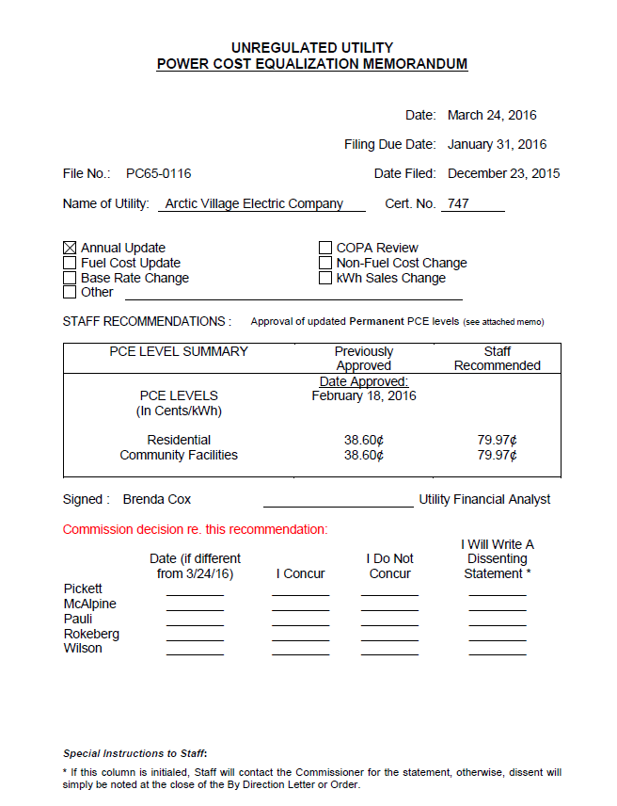
PCE levels
Seal City Electric Coop
The PCE levels can be found on the memorandum for an Annual Update, Fuel Cost Update, or other change that the utility has submitted.
$0.2012 $0.4032
$0.1532 $0.3625

Slide 32
Monthly customer charges by customer class
Customer Ledger
Utility Name: |  | Seal City Electric Coop |  |  |  |  | Customer class |  |  | Rate | PCE credit | Customer charge |  |  | Certified population |  |  | 154
Month: |  | January |  |  |  |  | Residential |  | R | $0.7500 | $0.4032 | $5.00 |  |  | Total eligible Community Facility kWh/month |  |  | 10,780
Date meters read: |  |  |  |  |  |  | Commercial |  | C | $0.7500 | $0.00 | $25.00
Number of days in period: |  |  |  |  |  |  | Community facility |  | CF | $0.7200 | $0.3625 | $10.00 |  |  | Total Community Facility kWh
 |  |  |  |  |  |  | State/federal |  | S/F | $0.75 | $0.00 | $30.00
Customer Name | Customer # | Meter # | Rate Class | Meter Reading |  | kWh Used |  | Charges |  | PCE Credits | Current activity | Old balance | Payments | Amount due | Past due
 |  |  |  | Current | Previous | Total | PCE eligible | Energy | Other |  |  |  |  |  | 30 day | 60 day | 90 day | 90+ day
Bagley, Felicia | 146 | 4970878 | R
Boehm, Sheldon | 31 | 67850176 | R
Brinson, Tennie | 151 | 47859795 | R
Bross, Polly | 274 | 62196874 | R
Bruss, Rosario | 92 | 65795659 | R
Bump, Stephen | 269 | 78544302 | R
Cadle, Lydia | 203 | 56888693 | R
A utility can charge each customer class may a unique monthly charge, or no monthly charge

Slide 33
Community facility PCE-eligible kWh
Customer Ledger
Utility Name: |  | Seal City Electric Coop |  |  |  |  | Customer class |  |  | Rate | PCE credit | Customer charge |  |  | Certified population |  |  | 154
Month: |  | January |  |  |  |  | Residential |  | R | $0.75 | $0.40 | $5.00 |  |  | Total eligible Community Facility kWh/month |  |  | 10,780
Date meters read: |  |  |  |  |  |  | Commercial |  | C | $0.75 | $0.00 | $25.00
Number of days in period: |  |  |  |  |  |  | Community facility |  | CF | $0.75 | $0.40 | $10.00 |  |  | Total Community Facility kWh
 |  |  |  |  |  |  | State/federal |  | S/F | $0.75 | $0.00 | $30.00
Customer Name | Customer # | Meter # | Rate Class | Meter Reading |  | kWh Used |  | Charges |  | PCE Credits | Current activity | Old balance | Payments | Amount due | Past due
 |  |  |  | Current | Previous | Total | PCE eligible | Energy | Other |  |  |  |  |  | 30 day | 60 day | 90 day | 90+ day
Bagley, Felicia | 146 | 4970878 | R
Boehm, Sheldon | 31 | 67850176 | R
Brinson, Tennie | 151 | 47859795 | R
Bross, Polly | 274 | 62196874 | R
Bruss, Rosario | 92 | 65795659 | R
Bump, Stephen | 269 | 78544302 | R
Cadle, Lydia | 203 | 56888693 | R
The maximum number of monthly community facility kWhs covered by PCE is equal to the population (as defined by the Alaska Division of Community and Regional Affairs [DCRA]) times 70 kWh per person.
The total community facility kWh cannot be greater than this maximum.

Slide 34
Customer information included on ledger
Customer Ledger
Utility Name: |  | Seal City Electric Coop |  |  |  |  | Customer class |  |  | Rate | PCE credit | Customer charge |  |  | Certified population |  |  | 154
Month: |  | January |  |  |  |  | Residential |  | R | $0.7500 | $0.4032 | $5.00 |  |  | Total eligible Community Facility kWh/month |  |  | 10,780
Date meters read: |  |  |  |  |  |  | Commercial |  | C | $0.7500 | $0.00 | $25.00
Number of days in period: |  |  |  |  |  |  | Community facility |  | CF | $0. | $0.3625 | $10.00 |  |  | Total Community Facility kWh
 |  |  |  |  |  |  | State/federal |  | S/F | $0.75 | $0.00 | $30.00
Customer Name | Customer # | Meter # | Rate Class | Meter Reading |  | kWh Used |  | Charges |  | PCE Credits | Current activity | Old balance | Payments | Amount due | Past due
 |  |  |  | Current | Previous | Total | PCE eligible | Energy | Other |  |  |  |  |  | 30 day | 60 day | 90 day | 90+ day
Bagley, Felicia | 146 | 4970878 | R
Boehm, Sheldon | 31 | 67850176 | R
Brinson, Tennie | 151 | 47859795 | R
Bross, Polly | 274 | 62196874 | R
Bruss, Rosario | 92 | 65795659 | R
Bump, Stephen | 269 | 78544302 | R
Cadle, Lydia | 203 | 56888693 | R
Customer information:
Name—alphabetize
Customer number
Meter number
Rate class—separate the customers by customer class and provide a sum for each customer class

Slide 35
Step 7: Transfer customer consumption data from meter reading sheet

Slide 36
Sort meter reading sheet
Commerical, community facility, federal/state, residential. May not be same order as customer ledger

Slide 37
Transfer meter reads to customer ledger
Customer Ledger
Utility Name: |  | Seal City Electric Coop |  |  |  |  | Customer class |  |  | Rate | PCE credit | Customer charge |  |  | Certified population |  |  | 154
Month: |  | January |  |  |  |  | Residential |  | R | $0.75 | $0.40 | $5.00 |  |  | Total eligible Community Facility kWh/month |  |  | 10,780
Date meters read: |  |  |  |  |  |  | Commercial |  | C | $0.75 | $0.00 | $25.00
Number of days in period: |  |  |  |  |  |  | Community facility |  | CF | $0.75 | $0.40 | $10.00 |  |  | Total Community Facility kWh
 |  |  |  |  |  |  | State/federal |  | S/F | $0.75 | $0.00 | $30.00
Customer Name | Customer # | Meter # | Rate Class | Meter Reading |  | kWh Used |  | Charges |  | PCE Credits | Current activity | Old balance | Payments | Amount due | Past due
 |  |  |  | Current | Previous | Total | PCE eligible | Energy | Other |  |  |  |  |  | 30 day | 60 day | 90 day | 90+ day
Bagley, Felicia | 146 | 4970878 | R
Boehm, Sheldon | 31 | 67850176 | R
Brinson, Tennie | 151 | 47859795 | R
Bross, Polly | 274 | 62196874 | R
Bruss, Rosario | 92 | 65795659 | R
Bump, Stephen | 269 | 78544302 | R
Cadle, Lydia | 203 | 56888693 | R
From the meter reading sheet, transfer:
Current meter reading
Previous meter reading
Total kWh used, including meter multiplier
If the customers are in the same order on the meter reading sheet and custom ledger, the data can be copied and pasted.

Slide 38
Double-check meter reads
Customer Ledger
Utility Name: |  | Seal City Electric Coop |  |  |  |  | Customer class |  |  | Rate | PCE credit | Customer charge |  |  | Certified population |  |  | 154
Month: |  | January |  |  |  |  | Residential |  | R | $0.75 | $0.4032 | $5.00 |  |  | Total eligible Community Facility kWh/month |  |  | 10,780
Date meters read: |  |  |  |  |  |  | Commercial |  | C | $0.75 | $0.00 | $25.00
Number of days in period: |  |  |  |  |  |  | Community facility |  | CF | $0.75 | $0.40 | $10.00 |  |  | Total Community Facility kWh
 |  |  |  |  |  |  | State/federal |  | S/F | $0.75 | $0.00 | $30.00
Customer Name | Customer # | Meter # | Rate Class | Meter Reading |  | kWh Used |  | Charges |  | PCE Credits | Current activity | Old balance | Payments | Amount due | Past due
 |  |  |  | Current | Previous | Total | PCE eligible | Energy | Other |  |  |  |  |  | 30 day | 60 day | 90 day | 90+ day
Bagley, Felicia | 146 | 4970878 | R | 23534 | 23534 | -
Boehm, Sheldon | 31 | 67850176 | R | 94381 | 94251 | 130
Brinson, Tennie | 151 | 47859795 | R | 75833 | 75133 | 700
Bross, Polly | 274 | 62196874 | R | 66112 | 65176 | 936
Bruss, Rosario | 92 | 65795659 | R | 39443 | 39443 | -
Bump, Stephen | 269 | 78544302 | R | 55310 | 55283 | 27
Cadle, Lydia | 203 | 56888693 | R | 70036 | 69874 | 162
Double-check any zero, very low or very high consumption values to make sure they are accurate.

Slide 39
Step 8: Calculate customer bills and PCE reimbursement

Slide 40
PCE-eligible kWh: Residential
Customer Ledger
Utility Name: |  | Seal City Electric Coop |  |  |  |  | Customer class |  |  | Rate | PCE credit | Customer charge |  |  | Certified population |  |  | 154
Month: |  | January |  |  |  |  | Residential |  | R | $0.7500 | $0.4032 | $5.00 |  |  | Total eligible Community Facility kWh/month |  |  | 10,780
Date meters read: |  |  |  |  |  |  | Commercial |  | C | $0.7500 | $0.00 | $25.00
Number of days in period: |  |  |  |  |  |  | Community facility |  | CF | $0.7200 | $0.3625 | $10.00 |  |  | Total Community Facility kWh
 |  |  |  |  |  |  | State/federal |  | S/F | $0.7500 | $0.00 | $30.00
Customer Name | Customer # | Meter # | Rate Class | Meter Reading |  | kWh Used |  | Charges |  | PCE Credits | Current activity | Old balance | Payments | Amount due | Past due
 |  |  |  | Current | Previous | Total | PCE eligible | Energy | Other |  |  |  |  |  | 30 day | 60 day | 90 day | 90+ day
Bagley, Felicia | 146 | 4970878 | R | 23534 | 23534 | - | -
Boehm, Sheldon | 31 | 67850176 | R | 94381 | 94251 | 130 | 130
Brinson, Tennie | 151 | 47859795 | R | 75833 | 75133 | 700 | 500
Bross, Polly | 274 | 62196874 | R | 66112 | 65176 | 936 | 500
Bruss, Rosario | 92 | 65795659 | R | 39443 | 39443 | - | -
Bump, Stephen | 269 | 78544302 | R | 55310 | 55283 | 27 | 27
Cadle, Lydia | 203 | 56888693 | R | 70036 | 69874 | 162 | 162
Residential PCE-eligible kWh is capped at 500 kWh/month. Customers pays retail rate for kWhs consumed over 500 kWh/month.
PCE eligible column should never be greater than 500 kWh for residential customers

Slide 41
PCE-eligible kWh: Community facilities
Customer Ledger
Utility Name: |  | Seal City Electric Coop |  |  |  |  | Customer class |  |  | Rate | PCE credit | Customer charge |  |  | Certified population |  |  | 154
Month: |  | January |  |  |  |  | Residential |  | R | $0.7500 | $0.4032 | $5.00 |  |  | Total eligible Community Facility kWh/month |  |  | 10,780
Date meters read: |  |  |  |  |  |  | Commercial |  | C | $0.7500 | $0.00 | $25.00
Number of days in period: |  |  |  |  |  |  | Community facility |  | CF | $0.7200 | $0.3625 | $10.00 |  |  | Total Community Facility kWh |  |  | 5,254
 |  |  |  |  |  |  | State/federal |  | S/F | $0.7500 | $0.00 | $30.00
Customer Name | Customer # | Meter # | Rate Class | Meter Reading |  | kWh Used |  | Charges |  | PCE Credits | Current activity | Old balance | Payments | Amount due | Past due
 |  |  |  | Current | Previous | Total | PCE eligible | Energy | Other |  |  |  |  |  | 30 day | 60 day | 90 day | 90+ day
Bagley, Felicia | 146 | 4970878 | R | 23534 | 23534 | - | -
Streetlight | 571 | 23360131 | CF | 32389 | 32366 | 345 | 345
Washeteria | 784 | 87402695 | CF | 59654 | 56151 | 3,503 | 3,503
Water treatment | 472 | 8288190 | CF | 49744 | 48338 | 1,406 | 1,406
Community Facilities Total: |  |  | CF |  | 5,254 | 5,254 | 5,254
Unlike residential customers, individual community facilities can get PCE reimbursement on more than 500 kWh/month.
Community facility PCE-eligible reimbursement is limited by the Total eligible community facility kWh/month. If the sales is greater than the community’s maximum, the utility must decide which customer(s) will receive the PCE credit

Slide 42
Calculating Customer Charges
Customer Ledger
Utility Name: |  | Seal City Electric Coop |  |  |  |  | Customer class |  |  | Rate | PCE credit | Customer charge |  |  | Certified population |  |  | 154
Month: |  | January |  |  |  |  | Residential |  | R | $0.7500 | $0.4032 | $5.00 |  |  | Total eligible Community Facility kWh/month |  |  | 10,780
Date meters read: |  |  |  |  |  |  | Commercial |  | C | $0.7500 | $0.00 | $25.00
Number of days in period: |  |  |  |  |  |  | Community facility |  | CF | $0.7200 | $0.3625 | $10.00 |  |  | Total Community Facility kWh |  |  | 5,254
 |  |  |  |  |  |  | State/federal |  | S/F | $0.7500 | $0.00 | $30.00
Customer Name | Customer # | Meter # | Rate Class | Meter Reading |  | kWh Used |  | Charges |  | PCE Credits | Current activity | Old balance | Payments | Amount due | Past due
 |  |  |  | Current | Previous | Total | PCE eligible | Energy | Other |  |  |  |  |  | 30 day | 60 day | 90 day | 90+ day
Bagley, Felicia | 146 | 4970878 | R | 23534 | 23534 | - | - | $0.00 | $5.00
Boehm, Sheldon | 31 | 67850176 | R | 94381 | 94251 | 130 | 130 | $97.50 | $5.00
Brinson, Tennie | 151 | 47859795 | R | 75833 | 75133 | 700 | 500 | $525.00 | $5.00
Bross, Polly | 274 | 62196874 | R | 66112 | 65176 | 936 | 500 | $702.00 | $5.00
Bruss, Rosario | 92 | 65795659 | R | 39443 | 39443 | - | - | $0.00 | $5.00
Bump, Stephen | 269 | 78544302 | R | 55310 | 55283 | 27 | 27 | $20.25 | $5.00
Cadle, Lydia | 203 | 56888693 | R | 70036 | 69874 | 162 | 162 | $121.50 | $5.00
Customer charges will include the cost of the electricity and potentially a flat monthly customer charge
Energy charge = kWh consumed * rate ($/kWh)
A customer charge might be defined by customer class

Slide 43
Calculating PCE Credits: Residential and Community Facility
Customer Ledger
Utility Name: |  | Seal City Electric Coop |  |  |  |  | Customer class |  |  | Rate | PCE credit | Customer charge |  |  | Certified population |  |  | 154
Month: |  | January |  |  |  |  | Residential |  | R | $0.7500 | $0.4032 | $5.00 |  |  | Total eligible Community Facility kWh/month |  |  | 10,780
Date meters read: |  |  |  |  |  |  | Commercial |  | C | $0.7500 | $0.00 | $25.00
Number of days in period: |  |  |  |  |  |  | Community facility |  | CF | $0.7200 | $0.3625 | $10.00 |  |  | Total Community Facility kWh |  |  | 5,254
 |  |  |  |  |  |  | State/federal |  | S/F | $0.7500 | $0.00 | $30.00
Customer Name | Customer # | Meter # | Rate Class | Meter Reading |  | kWh Used |  | Charges |  | PCE Credits | Current activity | Old balance | Payments | Amount due | Past due
 |  |  |  | Current | Previous | Total | PCE eligible | Energy | Other |  |  |  |  |  | 30 day | 60 day | 90 day | 90+ day
Bagley, Felicia | 146 | 4970878 | R | 23534 | 23534 | - | - | $0.00 | $5.00 | $0.00
Boehm, Sheldon | 31 | 67850176 | R | 94381 | 94251 | 130 | 130 | $97.50 | $5.00 | $52.00
Brinson, Tennie | 151 | 47859795 | R | 75833 | 75133 | 700 | 500 | $525.00 | $5.00 | $200.00
Bross, Polly | 274 | 62196874 | R | 66112 | 65176 | 936 | 500 | $702.00 | $5.00 | $200.00
Bruss, Rosario | 92 | 65795659 | R | 39443 | 39443 | - | - | $0.00 | $5.00 | $0.00
Bump, Stephen | 269 | 78544302 | R | 55310 | 55283 | 27 | 27 | $20.25 | $5.00 | $10.80
Cadle, Lydia | 203 | 56888693 | R | 70036 | 69874 | 162 | 162 | $121.50 | $5.00 | $64.80
The value here ($0.40/kWh) is used for as an example. Each utility will have a PCE rate calculated by the RCA.
The PCE credit is calculated by the RCA based on the utility’s reported, allowable expenses on the PCE annual report.
The RCA informs the utility of the rate on an annual basis on a letter order at the beginning of the fiscal year (July).
The utility’s PCE rate can also be obtained from AEA.
PCE Credit= PCE-eligible kWh * PCE credit rate ($/kWh)

Slide 44
Calculating Current Activity
Customer Ledger
Utility Name: |  | Seal City Electric Coop |  |  |  |  | Customer class |  |  | Rate | PCE credit | Customer charge |  |  | Certified population |  |  | 154
Month: |  | January |  |  |  |  | Residential |  | R | $0.75 | $0.40 | $5.00 |  |  | Total eligible Community Facility kWh/month |  |  | 10,780
Date meters read: |  |  |  |  |  |  | Commercial |  | C | $0.75 | $0.00 | $25.00
Number of days in period: |  |  |  |  |  |  | Community facility |  | CF | $0.75 | $0.40 | $10.00 |  |  | Total Community Facility kWh |  |  | 5,254
 |  |  |  |  |  |  | State/federal |  | S/F | $0.75 | $0.00 | $30.00
Customer Name | Customer # | Meter # | Rate Class | Meter Reading |  | kWh Used |  | Charges |  | PCE Credits | Current activity | Old balance | Payments | Amount due | Past due
 |  |  |  | Current | Previous | Total | PCE eligible | Energy | Other |  |  |  |  |  | 30 day | 60 day | 90 day | 90+ day
Bagley, Felicia | 146 | 4970878 | R | 23534 | 23534 | - | - | $0.00 | $5.00 | $0.00 | $5.00
Boehm, Sheldon | 31 | 67850176 | R | 94381 | 94251 | 130 | 130 | $97.50 | $5.00 | $52.00 | $50.50
Brinson, Tennie | 151 | 47859795 | R | 75833 | 75133 | 700 | 500 | $525.00 | $5.00 | $200.00 | $330.00
Bross, Polly | 274 | 62196874 | R | 66112 | 65176 | 936 | 500 | $702.00 | $5.00 | $200.00 | $507.00
Bruss, Rosario | 92 | 65795659 | R | 39443 | 39443 | - | - | $0.00 | $5.00 | $0.00 | $5.00
Bump, Stephen | 269 | 78544302 | R | 55310 | 55283 | 27 | 27 | $20.25 | $5.00 | $10.80 | $14.45
Cadle, Lydia | 203 | 56888693 | R | 70036 | 69874 | 162 | 162 | $121.50 | $5.00 | $64.80 | $61.70
Current activity is the amount the customer owes for the current billing period.
Current activity = Energy charge + Other charge – PCE Credits
$330.00 = $525.00 + $5.00 - $200.00

Slide 45
Sources of payment for customer charges
Customer Ledger
Utility Name: |  | Seal City Electric Coop |  |  |  |  | Customer class |  |  | Rate | PCE credit | Customer charge |  |  | Certified population |  |  | 154
Month: |  | January |  |  |  |  | Residential |  | R | $0.7500 | $0.4032 | $5.00 |  |  | Total eligible Community Facility kWh/month |  |  | 10,780
Date meters read: |  |  |  |  |  |  | Commercial |  | C | $0.7500 | $0.00 | $25.00
Number of days in period: |  |  |  |  |  |  | Community facility |  | CF | $0.7200 | $0.3625 | $10.00 |  |  | Total Community Facility kWh |  |  | 5,254
 |  |  |  |  |  |  | State/federal |  | S/F | $0.7500 | $0.00 | $30.00
Customer Name | Customer # | Meter # | Rate Class | Meter Reading |  | kWh Used |  | Charges |  | PCE Credits | Current activity | Old balance | Payments | Amount due | Past due
 |  |  |  | Current | Previous | Total | PCE eligible | Energy | Other |  |  |  |  |  | 30 day | 60 day | 90 day | 90+ day
Bagley, Felicia | 146 | 4970878 | R | 23534 | 23534 | - | - | $0.00 | $5.00 | $0.00 | $5.00
Boehm, Sheldon | 31 | 67850176 | R | 94381 | 94251 | 130 | 130 | $97.50 | $5.00 | $52.00 | $50.50
Brinson, Tennie | 151 | 47859795 | R | 75833 | 75133 | 700 | 500 | $525.00 | $5.00 | $200.00 | $330.00
Bross, Polly | 274 | 62196874 | R | 66112 | 65176 | 936 | 500 | $702.00 | $5.00 | $200.00 | $507.00
Bruss, Rosario | 92 | 65795659 | R | 39443 | 39443 | - | - | $0.00 | $5.00 | $0.00 | $5.00
Bump, Stephen | 269 | 78544302 | R | 55310 | 55283 | 27 | 27 | $20.25 | $5.00 | $10.80 | $14.45
Cadle, Lydia | 203 | 56888693 | R | 70036 | 69874 | 162 | 162 | $121.50 | $5.00 | $64.80 | $61.70
Part of the customer’s charge may be reimbursed by PCE
Customer charges will include the cost of the electricity and potentially a flat monthly customer charge
Current Activity:
Customers are responsible for the part of the monthly bill that is not reimbursed by PCE [Total charges less PCE credit]

Slide 46
Old Balance
Customer Ledger
Utility Name: |  | Seal City Electric Coop |  |  |  |  | Customer class |  |  | Rate | PCE credit | Customer charge |  |  | Certified population |  |  | 154
Month: |  | January |  |  |  |  | Residential |  | R | $0.75 | $0.40 | $5.00 |  |  | Total eligible Community Facility kWh/month |  |  | 10,780
Date meters read: |  |  |  |  |  |  | Commercial |  | C | $0.75 | $0.00 | $25.00
Number of days in period: |  |  |  |  |  |  | Community facility |  | CF | $0.75 | $0.40 | $10.00 |  |  | Total Community Facility kWh |  |  | 5,254
 |  |  |  |  |  |  | State/federal |  | S/F | $0.75 | $0.00 | $30.00
Customer Name | Customer # | Meter # | Rate Class | Meter Reading |  | kWh Used |  | Charges |  | PCE Credits | Current activity | Old balance | Payments | Amount due | Past due
 |  |  |  | Current | Previous | Total | PCE eligible | Energy | Other |  |  |  |  |  | 30 day | 60 day | 90 day | 90+ day
Bagley, Felicia | 146 | 4970878 | R | 23534 | 23534 | - | - | $0.00 | $5.00 | $0.00 | $5.00 | $93.10
Boehm, Sheldon | 31 | 67850176 | R | 94381 | 94251 | 130 | 130 | $97.50 | $5.00 | $52.00 | $50.50 | $80.15
Brinson, Tennie | 151 | 47859795 | R | 75833 | 75133 | 700 | 500 | $525.00 | $5.00 | $200.00 | $330.00 | $235.55
Bross, Polly | 274 | 62196874 | R | 66112 | 65176 | 936 | 500 | $702.00 | $5.00 | $200.00 | $507.00 | $94.85
Bruss, Rosario | 92 | 65795659 | R | 39443 | 39443 | - | - | $0.00 | $5.00 | $0.00 | $5.00 | $99.40
Bump, Stephen | 269 | 78544302 | R | 55310 | 55283 | 27 | 27 | $20.25 | $5.00 | $10.80 | $14.45 | $74.20
Cadle, Lydia | 203 | 56888693 | R | 70036 | 69874 | 162 | 162 | $121.50 | $5.00 | $64.80 | $61.70 | $110.25
Old Balance will be transferred from the Amount Due from the previous month

Slide 47
Payments
Customer Ledger
Utility Name: |  | Seal City Electric Coop |  |  |  |  | Customer class |  |  | Rate | PCE credit | Customer charge |  |  | Certified population |  |  | 154
Month: |  | January |  |  |  |  | Residential |  | R | $0.7500 | $0.4032 | $5.00 |  |  | Total eligible Community Facility kWh/month |  |  | 10,780
Date meters read: |  |  |  |  |  |  | Commercial |  | C | $0.7500 | $0.00 | $25.00
Number of days in period: |  |  |  |  |  |  | Community facility |  | CF | $0.7200 | $0.3625 | $10.00 |  |  | Total Community Facility kWh |  |  | 5,254
 |  |  |  |  |  |  | State/federal |  | S/F | $0.7500 | $0.00 | $30.00
Customer Name | Customer # | Meter # | Rate Class | Meter Reading |  | kWh Used |  | Charges |  | PCE Credits | Current activity | Old balance | Payments | Amount due | Past due
 |  |  |  | Current | Previous | Total | PCE eligible | Energy | Other |  |  |  |  |  | 30 day | 60 day | 90 day | 90+ day
Bagley, Felicia | 146 | 4970878 | R | 23534 | 23534 | - | - | $0.00 | $5.00 | $0.00 | $5.00 | $93.10 | $46.55
Boehm, Sheldon | 31 | 67850176 | R | 94381 | 94251 | 130 | 130 | $97.50 | $5.00 | $52.00 | $50.50 | $80.15 | $40.08
Brinson, Tennie | 151 | 47859795 | R | 75833 | 75133 | 700 | 500 | $525.00 | $5.00 | $200.00 | $330.00 | $235.55 | $0.00
Bross, Polly | 274 | 62196874 | R | 66112 | 65176 | 936 | 500 | $702.00 | $5.00 | $200.00 | $507.00 | $94.85 | $0.00
Bruss, Rosario | 92 | 65795659 | R | 39443 | 39443 | - | - | $0.00 | $5.00 | $0.00 | $5.00 | $99.40 | $99.40
Bump, Stephen | 269 | 78544302 | R | 55310 | 55283 | 27 | 27 | $20.25 | $5.00 | $10.80 | $14.45 | $74.20 | $37.10
Cadle, Lydia | 203 | 56888693 | R | 70036 | 69874 | 162 | 162 | $121.50 | $5.00 | $64.80 | $61.70 | $110.25 | $0.00
Payments will include the payments since the last billing was performed

Slide 48
Amount Due
Customer Ledger
Utility Name: |  | Seal City Electric Coop |  |  |  |  | Customer class |  |  | Rate | PCE credit | Customer charge |  |  | Certified population |  |  | 154
Month: |  | January |  |  |  |  | Residential |  | R | $0.7500 | $0.4032 | $5.00 |  |  | Total eligible Community Facility kWh/month |  |  | 10,780
Date meters read: |  |  |  |  |  |  | Commercial |  | C | $0.7500 | $0.00 | $25.00
Number of days in period: |  |  |  |  |  |  | Community facility |  | CF | $0.7200 | $0.3625 | $10.00 |  |  | Total Community Facility kWh |  |  | 5,254
 |  |  |  |  |  |  | State/federal |  | S/F | $0.7500 | $0.00 | $30.00
Customer Name | Customer # | Meter # | Rate Class | Meter Reading |  | kWh Used |  | Charges |  | PCE Credits | Current activity | Old balance | Payments | Amount due | Past due
 |  |  |  | Current | Previous | Total | PCE eligible | Energy | Other |  |  |  |  |  | 30 day | 60 day | 90 day | 90+ day
Bagley, Felicia | 146 | 4970878 | R | 23534 | 23534 | - | - | $0.00 | $5.00 | $0.00 | $5.00 | $93.10 | $46.55 | $51.55
Boehm, Sheldon | 31 | 67850176 | R | 94381 | 94251 | 130 | 130 | $97.50 | $5.00 | $52.00 | $50.50 | $80.15 | $40.08 | $90.58
Brinson, Tennie | 151 | 47859795 | R | 75833 | 75133 | 700 | 500 | $525.00 | $5.00 | $200.00 | $330.00 | $235.55 | $0.00 | $565.55
Bross, Polly | 274 | 62196874 | R | 66112 | 65176 | 936 | 500 | $702.00 | $5.00 | $200.00 | $507.00 | $94.85 | $0.00 | $601.85
Bruss, Rosario | 92 | 65795659 | R | 39443 | 39443 | - | - | $0.00 | $5.00 | $0.00 | $5.00 | $99.40 | $99.40 | $5.00
Bump, Stephen | 269 | 78544302 | R | 55310 | 55283 | 27 | 27 | $20.25 | $5.00 | $10.80 | $14.45 | $74.20 | $37.10 | $51.55
Cadle, Lydia | 203 | 56888693 | R | 70036 | 69874 | 162 | 162 | $121.50 | $5.00 | $64.80 | $61.70 | $110.25 | $0.00 | $171.95
Amount due include current month’s charges and any old unpaid balance
Amount due = Current activity + Old balance - Payments

Slide 49
Past Due
Customer Ledger
Utility Name: |  | Seal City Electric Coop |  |  |  |  | Customer class |  |  | Rate | PCE credit | Customer charge |  |  | Certified population |  |  | 154
Month: |  | January |  |  |  |  | Residential |  | R | $0.75 | $0.40 | $5.00 |  |  | Total eligible Community Facility kWh/month |  |  | 10,780
Date meters read: |  |  |  |  |  |  | Commercial |  | C | $0.75 | $0.00 | $25.00
Number of days in period: |  |  |  |  |  |  | Community facility |  | CF | $0.75 | $0.40 | $10.00 |  |  | Total Community Facility kWh |  |  | 5,254
 |  |  |  |  |  |  | State/federal |  | S/F | $0.75 | $0.00 | $30.00
Customer Name | Customer # | Meter # | Rate Class | Meter Reading |  | kWh Used |  | Charges |  | PCE Credits | Current activity | Old balance | Payments | Amount due | Past due
 |  |  |  | Current | Previous | Total | PCE eligible | Energy | Other |  |  |  |  |  | 30 day | 60 day | 90 day | 90+ day
Bagley, Felicia | 146 | 4970878 | R | 23534 | 23534 | - | - | $0.00 | $5.00 | $0.00 | $5.00 | $93.10 | $46.55 | $51.55 | $0.00 | $0.00 | $0.00 | $46.55
Boehm, Sheldon | 31 | 67850176 | R | 94381 | 94251 | 130 | 130 | $97.50 | $5.00 | $52.00 | $50.50 | $80.15 | $40.08 | $90.58 | $0.00 | $0.00 | $0.00 | $40.08
Brinson, Tennie | 151 | 47859795 | R | 75833 | 75133 | 700 | 500 | $525.00 | $5.00 | $200.00 | $330.00 | $235.55 | $0.00 | $565.55 | $0.00 | $0.00 | $235.55 | $0.00
Bross, Polly | 274 | 62196874 | R | 66112 | 65176 | 936 | 500 | $702.00 | $5.00 | $200.00 | $507.00 | $94.85 | $0.00 | $601.85 | $0.00 | $94.85 | $0.00 | $0.00
Bruss, Rosario | 92 | 65795659 | R | 39443 | 39443 | - | - | $0.00 | $5.00 | $0.00 | $5.00 | $99.40 | $99.40 | $5.00 | $0.00 | $0.00 | $0.00 | $0.00
Bump, Stephen | 269 | 78544302 | R | 55310 | 55283 | 27 | 27 | $20.25 | $5.00 | $10.80 | $14.45 | $74.20 | $37.10 | $51.55 | $0.00 | $0.00 | $37.10 | $0.00
Cadle, Lydia | 203 | 56888693 | R | 70036 | 69874 | 162 | 162 | $121.50 | $5.00 | $64.80 | $61.70 | $110.25 | $0.00 | $171.95 | $0.00 | $0.00 | $0.00 | $110.25
Track if customers’ accounts are past due. Follow utility policy and procedures for collecting on accounts in arrears that the board has put in place.
Per 3 AAC 107.260, AEA will not pay PCE credit for residential customer or community facility of the bill if the customer does not pay their portion of the monthly bill.
A customer may be able to continue to receive PCE, even with a large outstanding balance, if the customer enters into a payment agreement with the utility (see example on the next page). AEA must approve the repayment plan and will monitor the progress of the plan. In the event that the customer fails to follow the repayment plan, AEA may determine ineligibility for that customer until the outstanding balance has been paid in part or in whole.

Slide 50
Sample Payment Agreement
Seal Hollow Electric Company
123 Main Street
Seal Hollow, Alaska
907-444-4444
Payment Agreement
This letter is to inform you that you are not eligible to receive Power Cost Equalization credit due to your high outstanding balance. We have work out the following payment plans in order for you to pay your overdue bills. If you are interested, please select one of the following plans, sign the bottom of the page, and return your signed agreement to our office within 10 working day. If you do not have any income or cannot pay at all, please into our office to discuss an alternative plan.
12 Month Payment Plan: Outstanding bill _____ ÷ 12 = $ ________ + Current bill.
24 Month Payment Plan: Outstanding bill _____ ÷ 24 = $ ________ + Current bill.
30 Month Payment Plan: Outstanding bill _____ ÷ 30 = $ ________ + Current bill.
I, ________________________, understand that I must pay the total amount according to the payment plan I have chosen by the 30th of each month in order to receive PCE credits on the following month’s bill.
_____________________________ __________________________
Signature Date

Slide 51
Separate customer classes
Customer Ledger
[rows hidden]
Customer Name | Customer # | Meter # | Rate Class | Days in period | Meter Reading |  | kWh Used |  | Charges |  | PCE Credits | Current activity | Old balance | Payments | Amount due | Past due
 |  |  |  |  | Current | Previous | Total | PCE eligible | Energy | Other |  |  |  |  |  | 30 day | 60 day | 90 day | 90+ day
[rows hidden]
Kiddy, Adrianne | 367 | 36254846 | R | 31 | 38126 | 37954 | 172 | 172 | $129.00 | $5.00 | $68.80 | $65.20 | $13.65 | $13.65 | $65.20 | $0.00 | $0.00 | $0.00 | $0.00
Mccook, Ranae | 268 | 23226130 | R | 31 | 91724 | 91491 | 233 | 233 | $174.75 | $5.00 | $93.20 | $86.55 | $191.10 | $0.00 | $277.65 | $0.00 | $0.00 | $191.10 | $0.00
Residential Total: |  |  | R |  |  |  | 3,497 | 2,861 | $2,622.75 | $75.00 | $1,144.40 | $1,553.35 | $1,673.00 | $607.08 | $2,619.28 | $87.68 | $410.55 | $440.83 | $126.88
[rows hidden]
School #2 | 585 | 53169183 | C | 31 | 8272.2 | 8259.4 | 128 | - | $96.00 | $25.00 | $0.00 | $121.00 | $87.50 | $43.75 | $164.75 | $0.00 | $0.00 | $0.00 | $43.75
Telephone utility | 444 | 83790941 | C | 31 | 1920.7 | 1696.7 | 2,240 | - | $1,680.00 | $25.00 | $0.00 | $1,705.00 | $876.05 | $876.05 | $1,705.00 | $0.00 | $0.00 | $0.00 | $0.00
Village council | 781 | 58234867 | C | 31 | 19422 | 19380 | 42 | - | $31.50 | $25.00 | $0.00 | $56.50 | $82.60 | $0.00 | $139.10 | $0.00 | $0.00 | $0.00 | $82.60
Commercial Total: |  |  | C |  |  |  | 13,087 | - | $9,815.25 | $125.00 | $0.00 | $9,940.25 | $4,931.15 | $2,442.30 | ######## | $0.00 | $0.00 | $1,522.5 | $966.35
Streetlight | 571 | 23360131 | CF | 31 | 32389 | 32366 | 345 | 345 | $258.75 | $10.00 | $138.00 | $130.75 | $183.75 | $183.75 | $130.75 | $0.00 | $0.00 | $0.00 | $0.00
Washeteria | 784 | 87402695 | CF | 31 | 59654 | 56151 | 3,503 | 3,503 | $2,627.25 | $10.00 | $1,401.20 | $1,236.05 | $1,293.25 | $0.00 | $2,529.30 | $0.00 | $0.00 | $0.00 | $1,293.2
Water treatment | 472 | 8288190 | CF | 31 | 49744 | 48338 | 1,406 | 1,406 | $1,054.50 | $10.00 | $562.40 | $502.10 | $526.75 | $263.38 | $765.48 | $0.00 | $0.00 | $0.00 | $263.38
Community Facilities Total: |  |  | CF |  |  |  | 5,254 | 5,254 | $3,940.50 | 30 | $2,101.60 | $1,868.90 | $2,003.75 | $447.13 | $3,425.53 | $0.00 | $0.00 | $0.00 | $1,556.6
US Post Office | 433 | 58849395 | S/F | 31 | 79958 | 79614 | 344 | - | $258.00 | $30.00 | $0.00 | $288.00 | $209.30 | $209.30 | $288.00 | $0.00 | $0.00 | $0.00 | $0.00
State/Federal Total: |  |  | S/F |  |  |  | 344 | - | $258.00 | $30.00 | $0.00 | $288.00 | $209.30 | $209.30 | $288.00 | $0.00 | $0.00 | $0.00 | $0.00
The customer ledger should be arranged to separate out the customers by customer class. A total for each customer class should be provided.

Slide 52
Grand totals for customer classes
 |  | kWh Used |  | Charges |  | PCE Credits | Current activity | Old balance | Payments | Amount due | Past due
Grand Total | Number of customers | Total | PCE eligible | Energy | Other |  |  |  |  |  | 30 day | 60 day | 90 day | 90+ day
Residential | 15 | 3,497 | 2,861 | $2,622.75 | $75.00 | $1,144.40 | $1,553.35 | $1,673.00 | $716.10 | $2,510.25 | $228.73 | $0.00 | $226.45 | $501.73
Commercial | 4 | 13,087 | - | $9,815.25 | $125.00 | $0.00 | $9,940.25 | $4,931.15 | $4,364.33 | $10,507.08 | $41.30 | $525.53 | $0.00 | $0.00
Community Facilities | 3 | 5,254 | 5,254 | $3,940.50 | $30.00 | $2,101.60 | $1,868.90 | $2,003.75 | $91.88 | $3,780.78 | $618.63 | $0.00 | $1,293.25 | $0.00
State and Federal | 1 | 344 | - | $258.00 | $30.00 | $0.00 | $288.00 | $209.30 | $104.65 | $392.65 | $0.00 | $104.65 | $0.00 | $0.00
Unbilled | 0
Total | 23 | 22,182 | 8,115 | $16,636.50 | $260.00 | $3,246.00 | $13,650.50 | $8,817.20 | $5,276.95 | $17,190.75 | $888.65 | $630.18 | $1,519.70 | $501.73
Sum the number of customers for each rate class. If a customer has multiple meters, make sure to just count them once
Total that will be reimbursed by PCE for the current month of meter reads.
Total amount due to utility, including past due balances

Slide 53
Check for collection rate
 | kWh Used |  | Charges |  | PCE Credits | Current activity | Old balance | Payments | Amount due | Past due
Grand Total | Total | PCE eligible | Energy | Other |  |  |  |  |  | 30 day | 60 day | 90 day | 90+ day
Residential | 3,497 | 2,861 | $2,622.75 | $75.00 | $1,144.40 | $1,553.35 | $1,673.00 | $716.10 | $2,510.25 | $228.73 | $0.00 | $226.45 | $501.73
Commercial | 13,087 | - | $9,815.25 | $125.00 | $0.00 | $9,940.25 | $4,931.15 | $4,364.33 | $10,507.08 | $41.30 | $525.53 | $0.00 | $0.00
Community Facilities | 5,254 | 5,254 | $3,940.50 | $30.00 | $2,101.60 | $1,868.90 | $2,003.75 | $91.88 | $3,780.78 | $618.63 | $0.00 | $1,293.25 | $0.00
State and Federal | 344 | - | $258.00 | $30.00 | $0.00 | $288.00 | $209.30 | $104.65 | $392.65 | $0.00 | $104.65 | $0.00 | $0.00
Unbilled
Total | 22,182 | 8,115 | $16,636.50 | $260.00 | $3,246.00 | $13,650.50 | $8,817.20 | $5,276.95 | $17,190.75 | $888.65 | $630.18 | $1,519.70 | $501.73
If Payments are less than Old Balance (as is the case in the example), the utility might not be enforcing bill collection policy and procedures and collecting sufficient revenue to pay staff and materials/supplies to keep the utility functioning.

