Slide 1
Power Cost Equalization Monthly Reporting
Guide for completing the Utility Monthly Report to the Alaska Energy Authority

Slide 2
The goal of the Power Cost Equalization (PCE) Program is to provide economic assistance to customers in rural areas of Alaska where, in many instances, the kilowatt-hour charge for electricity can be three to five times higher than the charge in more urban areas of the state.
One of the requirements for participating in the PCE program is to provide monthly reports to the Alaska Energy Authority (AEA) that will provide sufficient information for AEA to be able to reimburse PCE-eligible customers.
PCE-eligible utilities are required to submit the Utility Monthly Report (UMR) within 10 working days after the end of the billing period for customers to receive reimbursement.
The purpose of this guide is twofold:
Provide step-by-step instructions on how to fill out the Utility Monthly Report form, and
Explain how to use the information on the forms to track important aspects of the utility’s health
Filling out the UMR should not be time consuming. If you have all of the necessary documents up-to-date and on hand, filling out the UMR should take less than an hour to complete.
To make it easy to fill out the UMR, you should have the following documents from reporting period on hand:
  Customer ledger
  Power plant daily inspection log
  The most current RCA Memorandum that includes the approved PCE level
  Fuel cost update from RCA, if not included in #3
  General ledger
  Streetlight info (if not metered)

Slide 3
The Utility Monthly Report (UMR)

Slide 4
The Utility Monthly Report (UMR) includes the information required for AEA to process PCE reimbursement as well other data required per statute and regulation. By providing accurate information on the UMR, a utility can make it easier to process. If a utility submits data that is incorrect, contradictory, or otherwise difficult to understand, AEA will have to contact the utility for additional and/or clarifying information. This will slow down processing of payments and cause the utility to spend time and money to respond to questions by phone and/or email.
The are now two ways that a utility can submit the information to AEA:
  Standardized UMR in an Microsoft Excel format provided by AEA to each utility—can be submitted by EMAIL? SNAIL MAIL?
  Online PCE portal
For the purpose of this guide, we will be using the Microsoft Excel version of the UMR. The online PCE portal requires the same information as the Excel version, just in a different format. If you are interested in learning more about the online PCE port, please see…..
The UMR is split into several sections over two pages. The first page has six sections that need to be completed. The information for the sections summarizes information from a number of different sources that the utility is required to keep for several years. This information provides the basis amount of PCE reimbursement provided to the utility.
The second page is specific to community facilities and streetlights (which are also eligible for PCE reimbursement). Page 2 is not required but can be helpful for filling out Section D on Page 1.
The rest of this guide will use the two pages of the UMR, whiting out the sections of the form to focus on one specific section. Additional pages may be included that show where the data is to be found on other documents—such as the customer ledger or powerhouse log.

Slide 7
Filling in the UMR

Slide 8
Billing Period: Dates of beginning and end of billing period. Start the day after the end of the previous billing period. Consistent with meter reading
Number of Days: [no more than 31 days]. 12 per year required. [What happens if more than 31?]
Meters read: meter reading sheet. Consistent throughout year, same day of the month.
Bills mailed: Date, not more than 10 days after meter readings (end of billing period)
Regulated (Yes/No): Economically regulated. RCA must approve rates [why do we need this?]
Utility contact information:
If anything has changed, send to AEA in writing. Contact name, phone, email, person who fill out form and can answer questions. [do we have a database of contact info?] [should this be a utility person or the contractor, if there is one?]

Slide 9
DCCED certified community population: The population is provided by AEA at beginning of fiscal year (July). The population is used to determine the eligible kWh for community facilities. [Does the green indicate that it is already included on the sheet?]
No. of customers: The number of customers by class will be found on the customer ledger. On a monthly basis, the utility should update the customer ledger—removing customers as accounts close and adding new customers when appropriate. Include donated/unbilled customers. This should be only count unique customers—if a customer has multiple meters, they should only be counted once.
If using Excel form, the “Total” automatically adds in the green cell.

Slide 10
Number of customers
The customer ledger should include a section that summarizes all of the information for each customer class. This summary section will be used for a number of fields on the UMR. An example, showing a portion of the ledger, is included below.

Slide 11
The information for Section B will come from several sources: 1) the plant log, 2) the most recent Memorandum from the RCA (either for an annual update or fuel cost update), 3) the utility’s general ledger, and 4) any invoices received for power purchased from another entity.
kWh Generated and Purchased: The utility is required to have a generation meter for each source. The operator should record the meter reads on the plant log three times per day. The amount generated (or purchased) for each source is the
difference between the meter reading at the end of the current and previous month. [See Page 14 for example]
When filling out the cells, every source should only be included once. For example, if the utility purchases wind power for a vendor, the purchased wind power should only be put into “Total kWh Purchased”, and not “Wind”.
“Total kWh Available for Sale” automatically sums all of the generation sources.
Price of fuel: Use the value that had been approved by the RCA per the most recent PCE Memorandum, it will likely have a box checked “Annual Update” or “Fuel Cost Update”. The value will likely be found under the heading “Fuel Costs” in the text of the memorandum. [See Page 14 for example]
Fuel used (Gallons): The utility is required to have a fuel meter. The operator should record the fuel meter reading on the plant log three times per day. [See Page 13 for example]
Total fuel cost: This value is calculated for you if using Excel. The value is found by multiplying the number of gallons by the price of fuel approved by the RCA.
Total Non-Fuel Exp: The non-fuel expenses will be found on the utility’s general ledger.

Slide 12
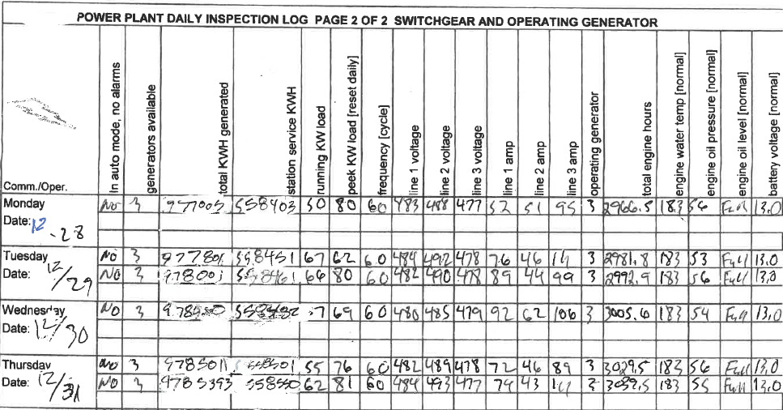
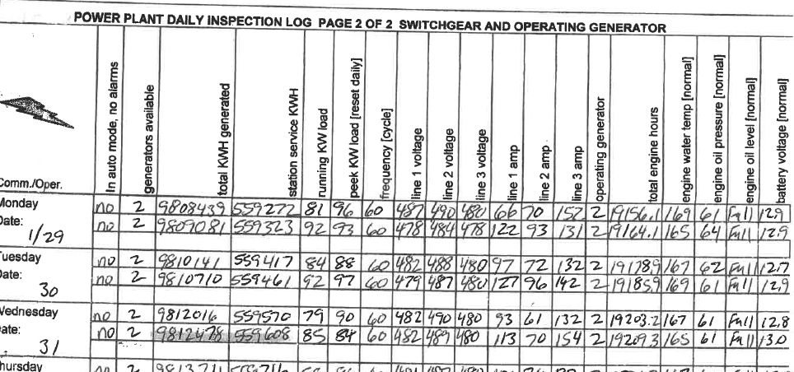
kWh Generated and Purchased
On the power plant daily inspection log find:
Total KWH generated reading at end last billing cycle (9785393)
Total KWH Generated reading at end of current billing cycle (9812478)
Subtract the current reading from the previous reading
9812478 - 9785393 = 27,085 kWh

Slide 13
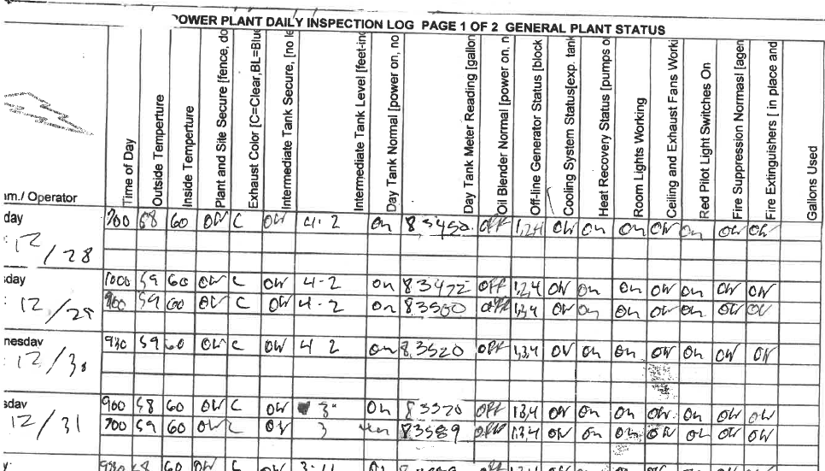
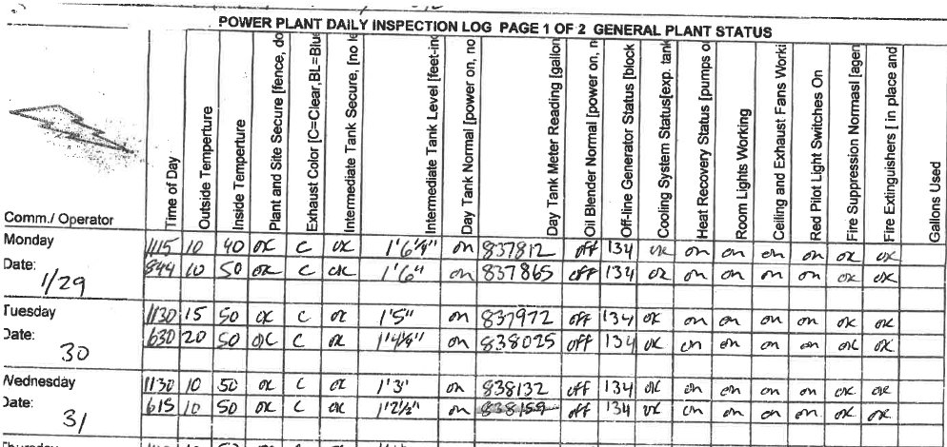
Fuel used (Gallons)
To find the number of gallons of fuel used, use the power plant daily inspection log to find:
Day tank meter reading at end last billing cycle
Day tank meter reading at end of current billing cycle
Subtract the current reading from the previous reading
838159-838859 = 2300 gallons
5

Slide 14
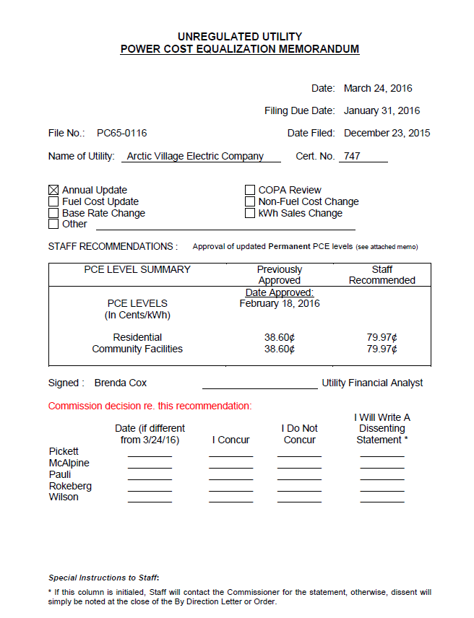

Price of fuel
Seal City Electric Coop
The RCA-approved price of fuel can be found on Memorandum from the RCA. To the left is the first page of the Memorandum.
$0.2012 $0.4032
$0.1532 $0.3625
In the body of the Memorandum, find a section called “Fuel Costs”. Below is an example from a PCE-eligible community.
Whenever the utility purchases fuel, it must report the cost and number of gallons to the RCA so that the fuel price and PCE rate can be updated.
SCEC

Slide 15
Section C calculates “line loss”, which is the percentage electricity generated and/or purchased that cannot be accounted for by sales or station service. Information for this section is found from two different sources: 1) the power plant log and 2) the customer ledger.
Station service: The utility is required to have meter that records the electricity consumed by the power plant for lights, pumps, fans, electronics, etc. The operator should record this station service on the plant log. The station service for the reporting period is the difference between the meter reading at the end of the current and previous month. [See Page 16 for example]
Peak demand: The utility is required to have a meter that records the peak demand. The operator should record this value on the power plant log, resetting it each time. The highest value for the peak demand for the billing period should be recorded. [See Page 17 for an example].
Total kWh Sold To: The customer ledger should include a section that summarizes the kWh sales by customer class. To make it easier for reporting, most utilities name the customer classes with the same names on the UMR: Residential, Commercial, Community Facilities, Federal/State, and Unbilled. Even if they are not billed, streetlights should be included under “Community Facilities”, since they are eligible for PCE reimbursement.
The two green cells in this section are calculated based on values in Section B and C. The first green cell calculates the “Total kWh available for Sale” that are not accounted for in “Total Sold” or “Station Service”. A value below zero means that more kWhs were sold than generated or purchased, which is impossible. Double check all the sales and generation/purchased to look for errors.
“Line Loss” calculates the unaccounted kWhs as a percentage of the “Total kWh available for Sale”. On an annual basis, if the “Line Loss” value is greater than 12%, the RCA will reduce the utility’s PCE rate. High “Line Loss” values are frequently due to metering and billing errors.

Slide 16
Station service
(Powerhouse Consumption)
On the power plant daily inspection log find:
Station service KWH reading at end last billing cycle (558550)
Station service KWH reading at end of current billing cycle (559608)
Subtract the current reading from the previous reading
559608 - 558550 = 1,058 kWh

Slide 17
Peak Demand from Power Plant Log
On the power plant daily inspection log find:
Peak kW load
Look through all of the values and find the largest value during the current period

Slide 18
Total kWh Sold To:
The customer ledger will be submitted with the UMR. The last section of the customer ledger should include a summary of each of the customer classes. The total sales by customer class should be one of the columns that should be summarized. This is shown below--only a portion of the summary section is included below.

Slide 19
Current residential price: The current residential rate should be consistent with the utility’s tariff and be included out to four decimal places.
PCE Eligible kWh: #2 includes four rows and five columns. Numbers should only be put into the yellow cells, the green cells include calculations.
To fill out the table, start with the row “Present PCE rate ($/kWh)”. The table includes space for up to four different PCE rates. Use the columns to put in the PCE rates approved by the RCA for each customer class. In the example below, the utility has two different PCE rates, $0.4032/kWh and $0.3625/kWh. [See Page 14 for an example]
Using the customer ledger, put the number of kWh sold by customer class and PCE rate. In the example below, “Residential kWh” had sales of 2,861 kWh and the rate was $0.4032, so it was put in the first column. [See Page 20]
The customer ledger then showed there were 5,254 kWh PCE-eligible kWhs sold to “Community Facilities kWh”. The PCE rate for these kWh was $0.3625, so the sales are put in the second column.
The utility does not have any other PCE rates, so the other columns are left blank.
The last column (in green) sums the PCE eligible kWh for residential, community facility, and total.
The small red type “Comm. Facility Max kWh” provides a calculation so that community’s community facilities limit is not exceeded. In this case, the total “Community Facility kWh” of 5,254 kWh is below the maximum 8,470 kWh.
Total PCE credit ($). If using the Excel version, the columns will automatically multiply the PCE rate by the eligible kWh to get the PCE credit. The far bottom right is the total amount of PCE credit that the utility expects to receive.

Slide 20
PCE eligible kWh:
The customer ledger should include all of the information needed to fill out Section D of the UMR. The customer ledger should include a summary table that will be used to fill in the numbers for #2 of Section D. One portion of the customer ledger is copied below.
Residential kWh: It is important the customer ledger limits the PCE-eligible kWh per residential customer to the statutory maximum of 500 kWh per month. All PCE-eligible residential kWhs will likely have the same PCE rate and will input in the same column.
Community Facilities kWh: Communities may or may not have the same PCE rate as residential customers. If customer facilities have the same PCE rate as residential customers then the kWh can be put in the same column. If there is a separate rate, they should be put in the next column
The values in this table should be consistent with Page 2 of UMR (see pages 23-25 of this guide if the utility chooses to use it)

Slide 21
Section E: The certification of the UMR is an important step prior to submittal. The utility must certify that the information is true and correct. The information provided for the PCE program is important for being able to provide PCE-eligible customers with credit to reduce their costs, but it also helps the state figure out the best ways to assist communities with energy costs.
Many different groups use the data from PCE to understand how people use energy. If the data is not accurate, the state may be less effective in helping people and communities.
The boxed section to the bottom right is for AEA’s use. Please do not put anything in this area.

Slide 22
Utility Monthly Report For Community Facilities

Slide 23
Page 2 of the UMR is not required.
At the top of the page, the Utility Name and Billing period, if using Excel form, will carry over from Page 1 of the UMR.
In the table, you will need to include the name of each community facility that has been certified by AEA to be eligible for PCE reimbursement. Do not include residential customers or customers not certified as community facilities by AEA.
Like the table in Section D of the UMR, if there are multiple rates place the rates in the “Present PCE Rate” row. In the columns for each community facility, use the customer ledger to fill in the number of PCE-eligible kWhs that were consumed by that facility by each PCE Rate. The Total kWh summed in the rightmost column should equal the total PCE-eligible kWh on the customer ledger.
The row “Total Eligible Community Facility kWh” in this table should agree with the “Community Facilities kWh” in Section D of Page 1 of the UMR. This row, highlighted in green, will automatically sum the rows in the column.
The “Total PCE credit” will automatically be calculated for each PCE rate, which is then summed in the far right of the table.

Slide 24
Community facilities PCE-eligible kWh:
Use the customer ledger, an example is shown below, to record the PCE-eligible kWh for each community facility. The customer ledger might not record if there are multiple PCE rates for a given facility. If that is the case, any equations that are used to determine the PCE credits may need to be broken into pieces to be able to fill out the table on Page 2 of the UMR.
Customer Name | Rate Class | Number of days in billing period | Meter Reading |  | kWh Used |  | Charges |  | PCE Credits
 |  |  | Current | Previous | Total | PCE eligible | Energy | Other
Streetlight | CF | 31 | 32389 | 32366 | 345 | 345 | $258.75 | $10.00 | $125.06
Washeteria | CF | 31 | 59654 | 56151 | 3,503 | 3,503 | $2,627.25 | $10.00 | $1,269.84
Water treatment | CF | 31 | 49744 | 48338 | 1,406 | 1,406 | $1,054.50 | $10.00 | $509.68
Community Facilities Total: | CF |  |  |  | 5,254 | 5,254 | $3,940.50 | $30.00 | $1,904.58

Slide 25
While streetlights are not required to be metered to be eligible for PCE reimbursement, it is always good to meter all customers. Metering allows the utility to account for all kWhs that are generated and can inform the community if lights are on unnecessarily, which wastes electricity.
If a community decides to not meter its streetlights, a calculation can be used to estimate the average monthly consumption from the streetlights. The section below entitled “Streetlights” provides the calculation. You only need to have the wattage of the bulbs and the number of lights. To use the calculator fill in the values in the yellow cells. If the streetlights do not all have the same wattage, you will need to do the calculation for each different wattage.
The “Eligible kWh” should be included on the customer ledger under Community Facilities.
Disregard the two rows below the calculator. This section to be disregarded is circled below.

Slide 26
Checklist before submitting UMR
Signed
Customer ledger included
Reasonable values

